Slide 1
Diagnosis of 13 cell types reference

Slide 2
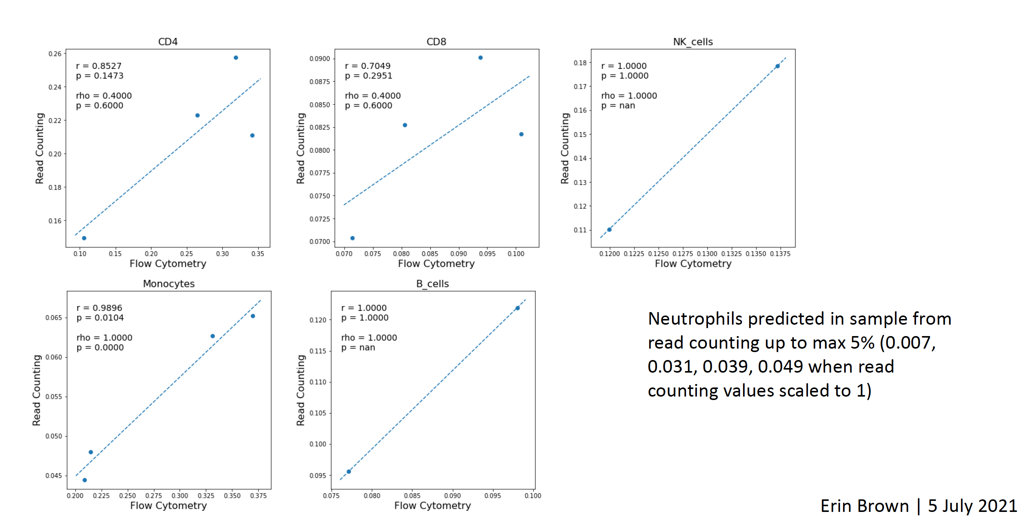
Read counting using 13 cell type reference on bulk PBMC (yesterday’s slide)
Individual cell types show correlation. However, Monocytes are underestimated in read counting

Slide 3
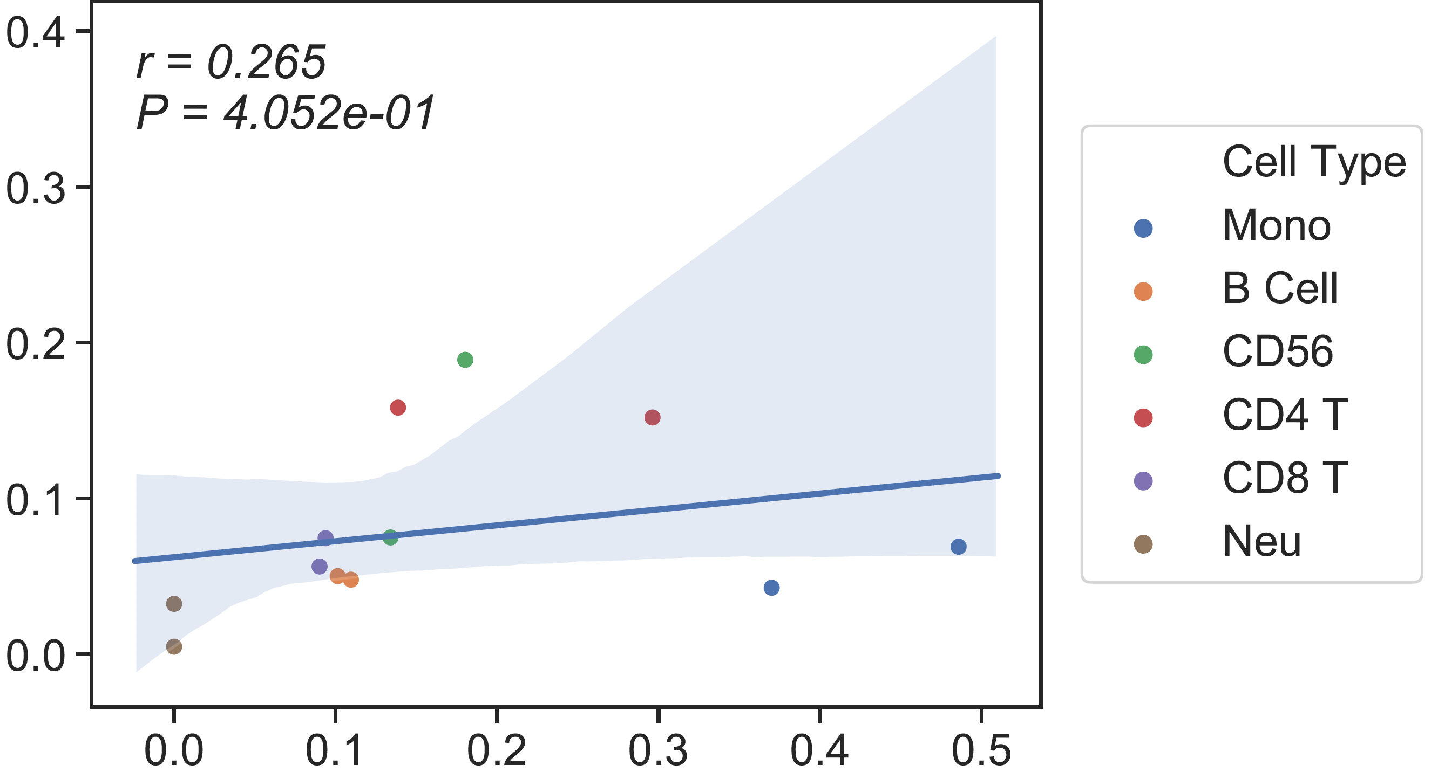
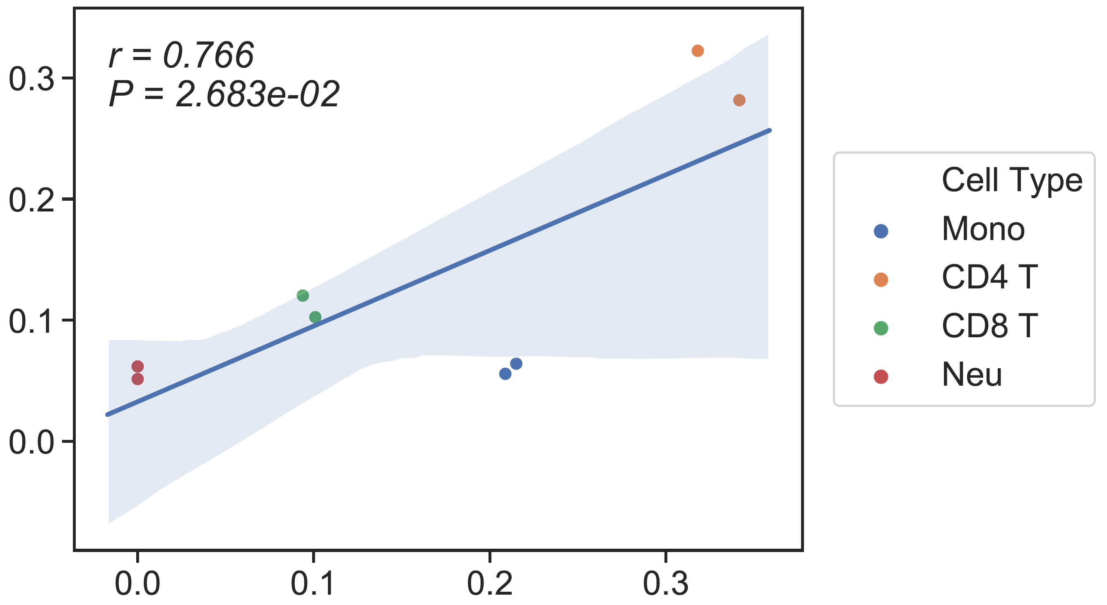
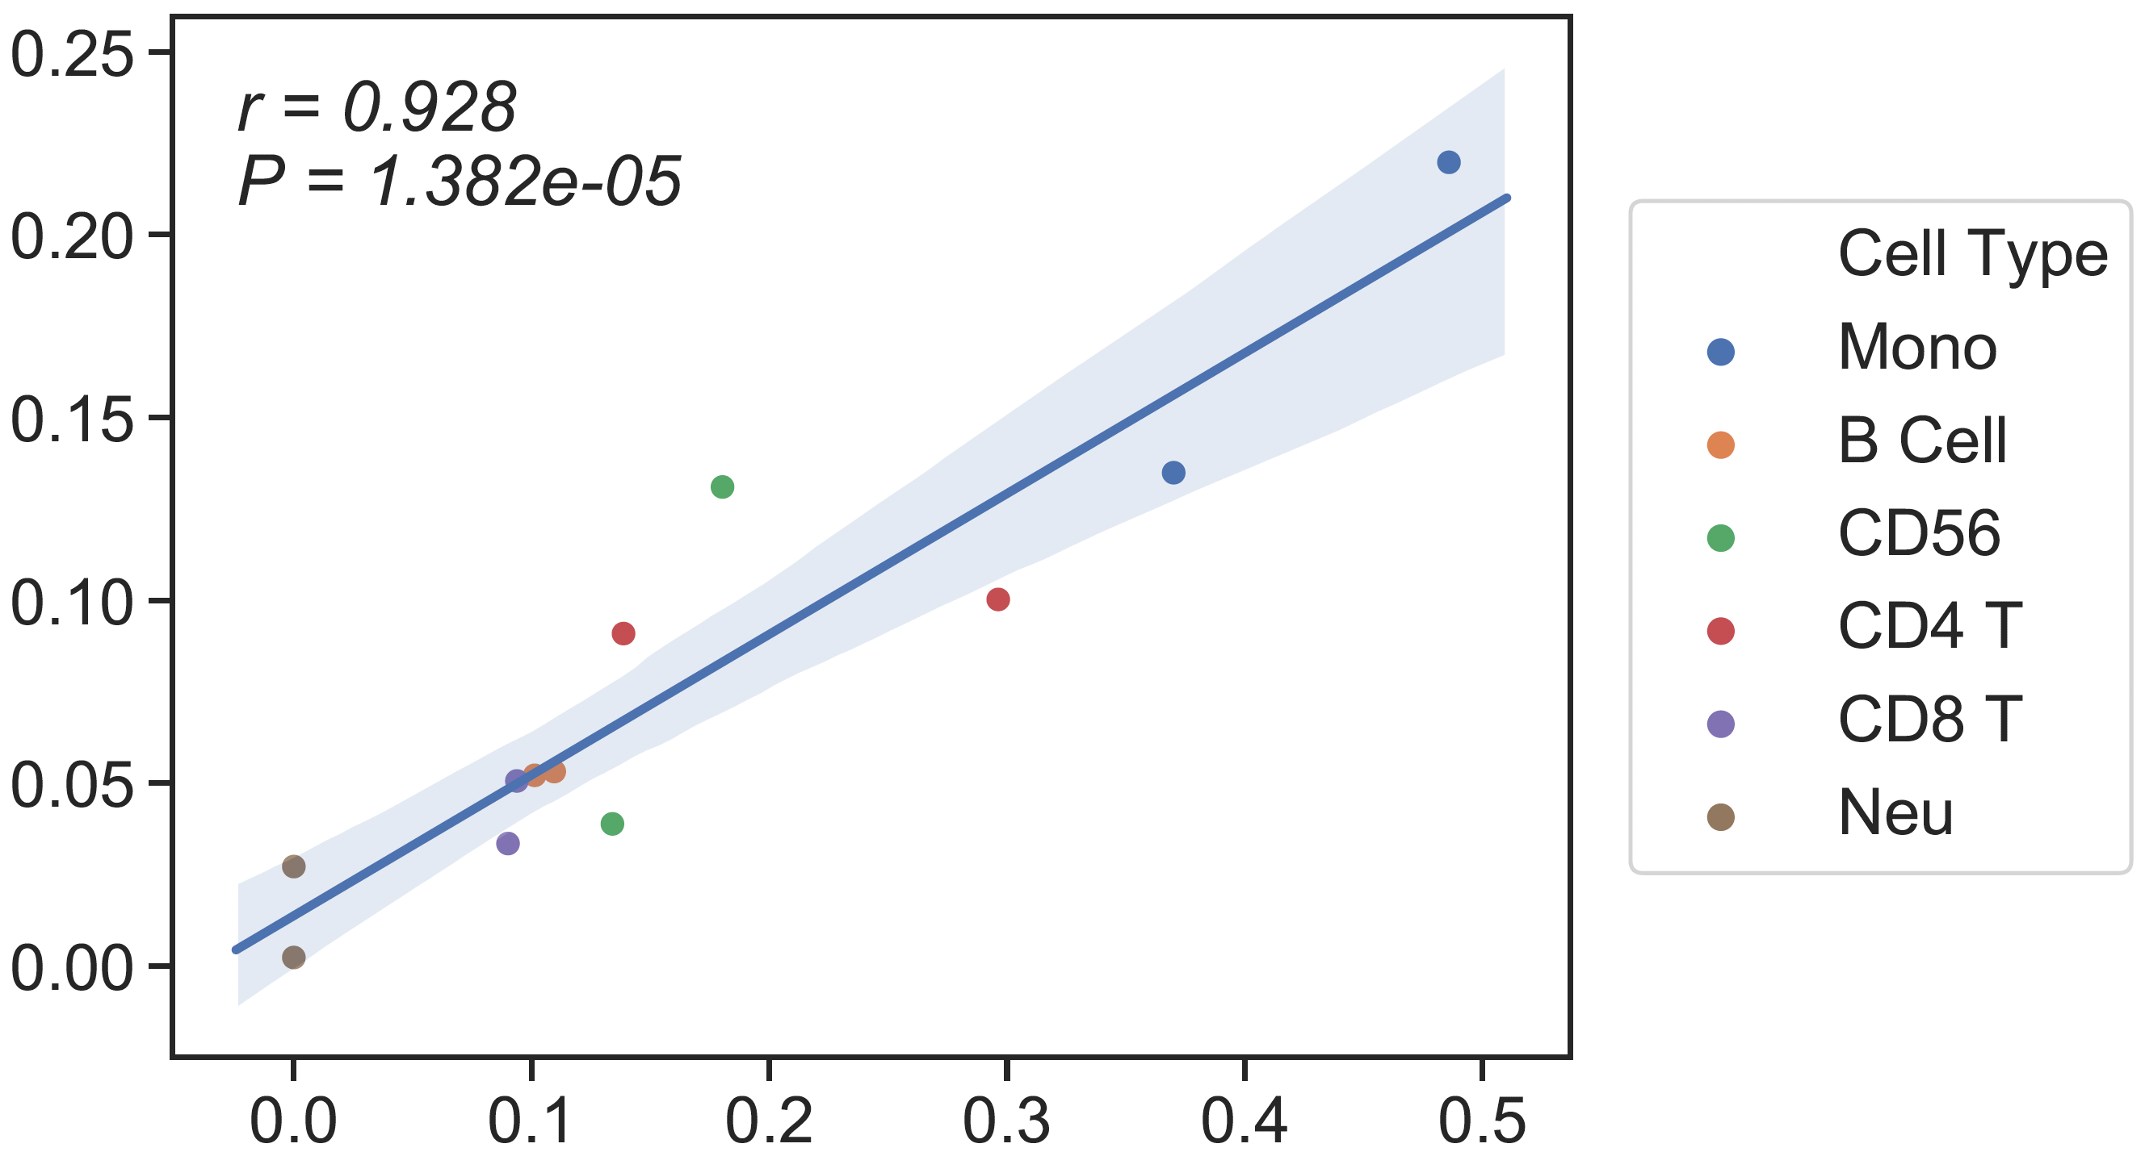
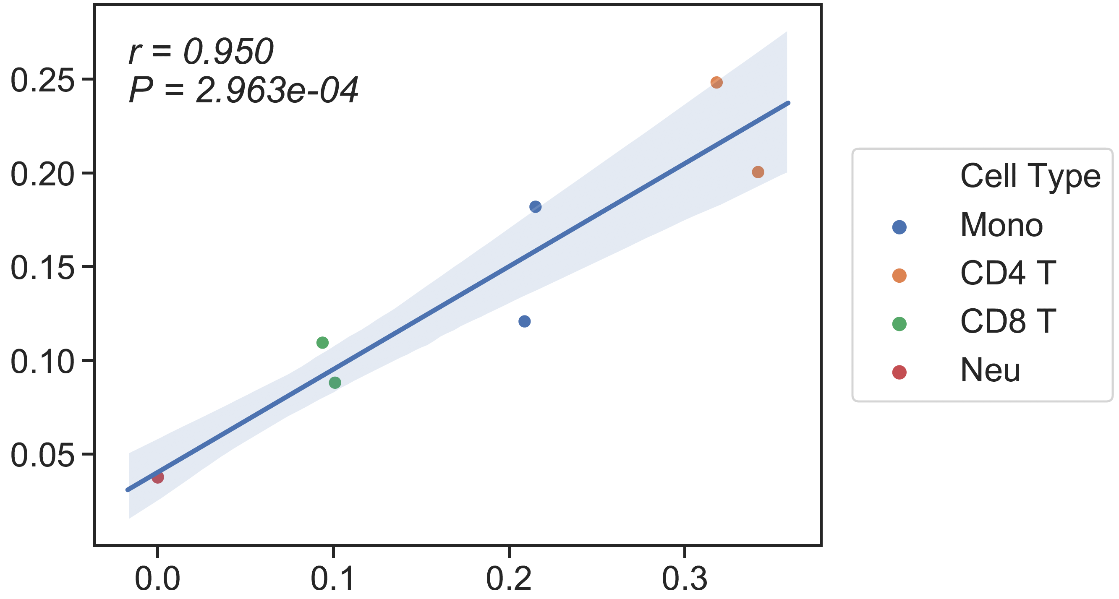
Performance of 6 cell types and 13 cell types reference (Absolute read counting)
Batch1
(Depth ~ 15x, input ~ 25ng)
Mono of 13 cell types reference seems problematic
Batch2
(Depth ~ 30x, input ~ 100ng)
13 cell types reference
rho= 0.51
rho= 0.67
6 cell types reference
(previous result)
rho= 0.89
rho= 0.95
Flow cytometry
Flow cytometry
Notes:
perfectrejcode

Slide 4
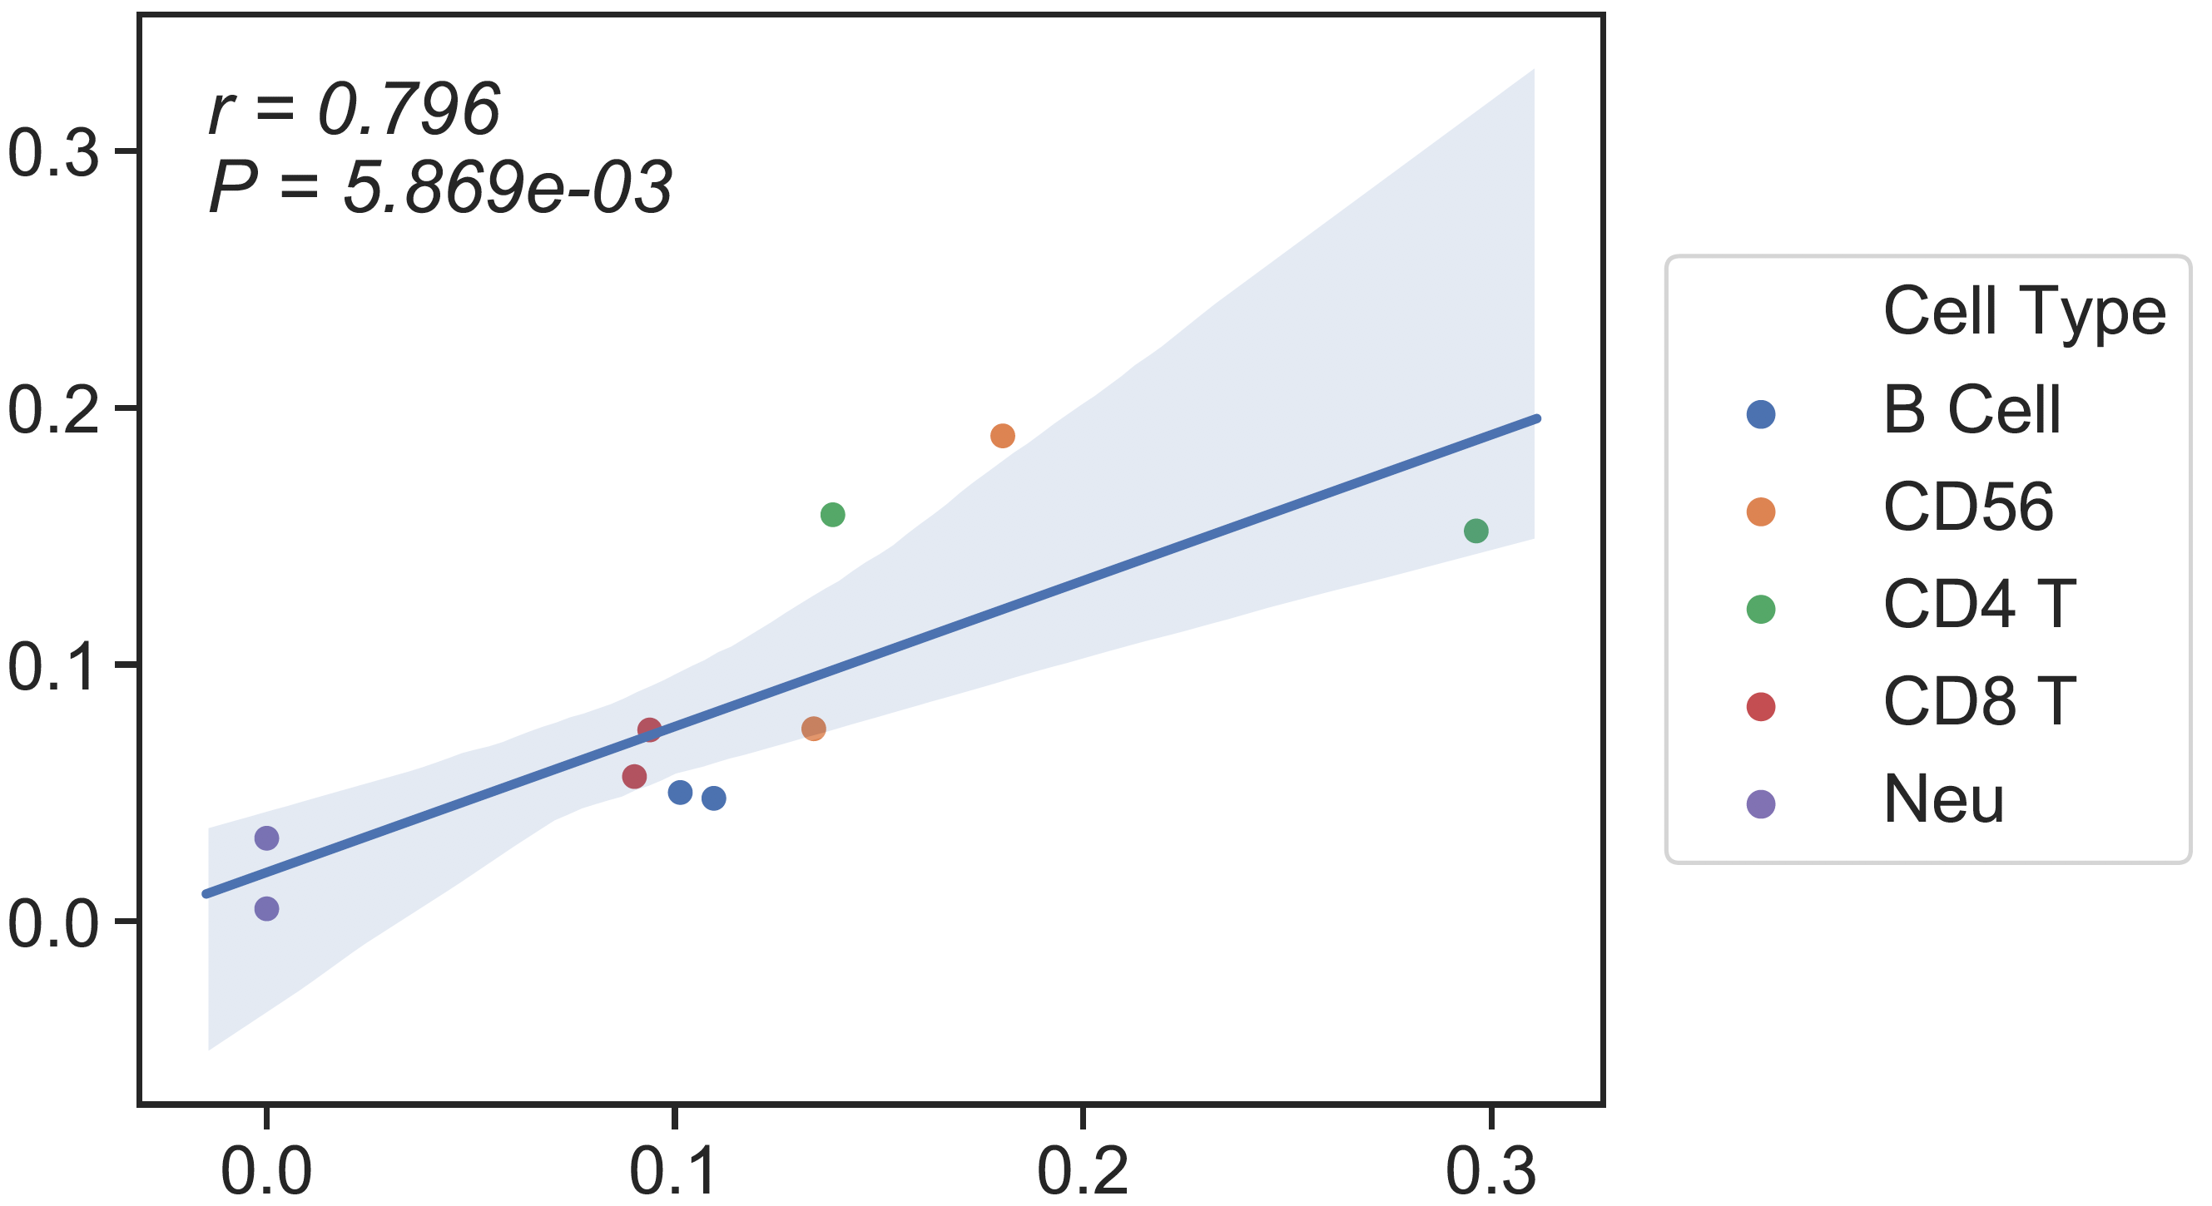
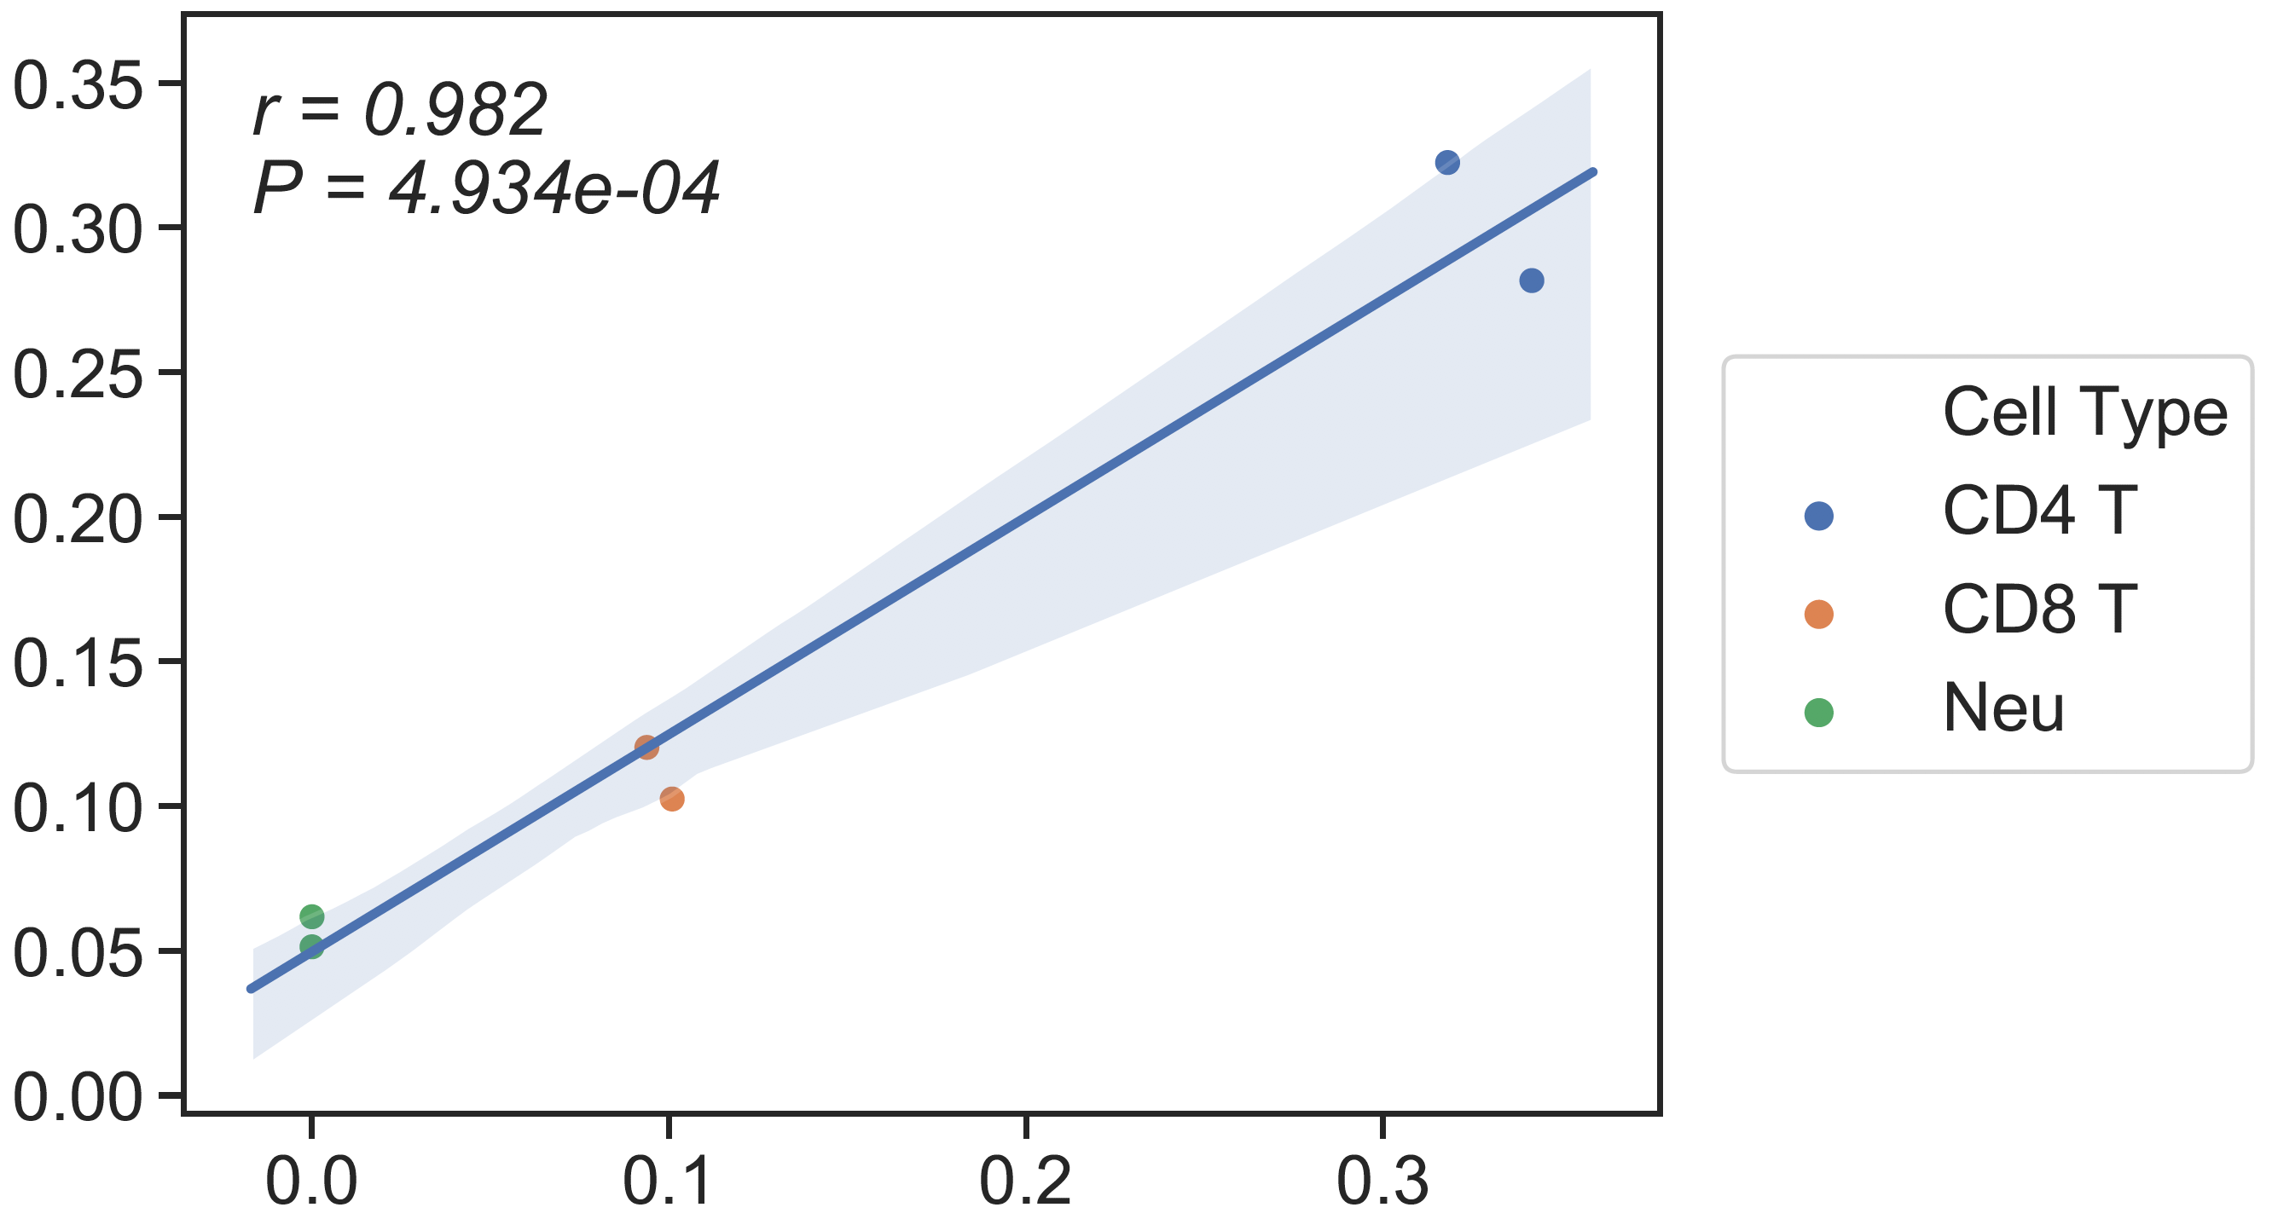
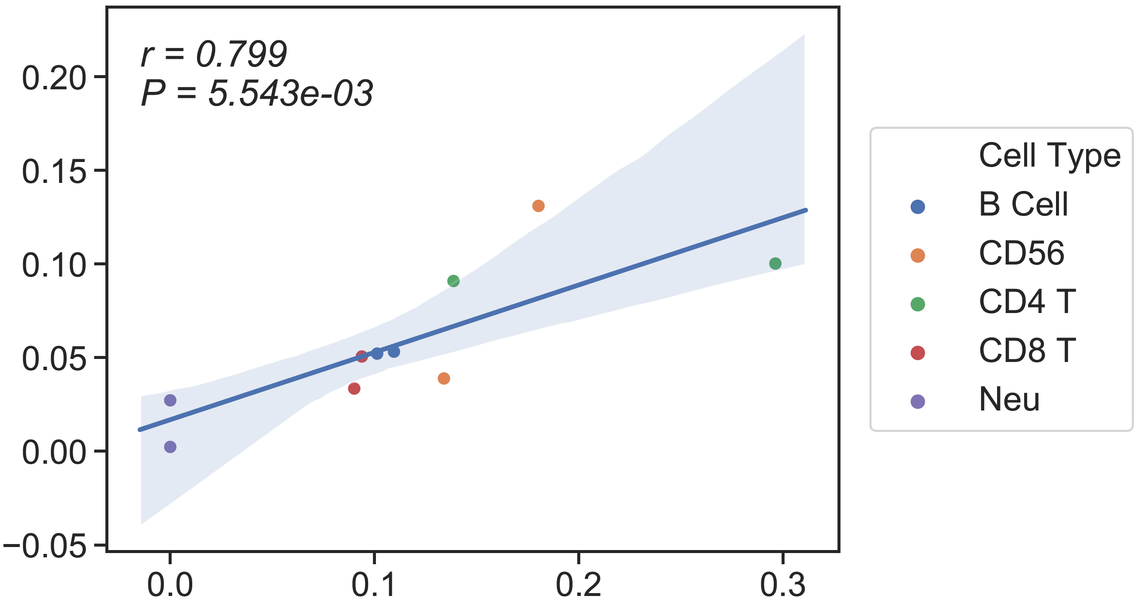
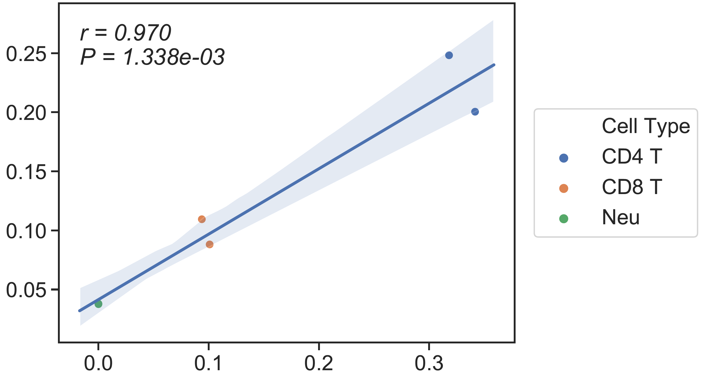
Performance of 6 cell types and 13 cell types reference (Absolute read counting)
Batch1
(Depth ~ 15x, input ~ 25ng)
Without Mono
Batch2
(Depth ~ 30x, input ~ 100ng)
13 cell types reference
rho= 0.87
rho= 0.85
6 cell types reference
(previous result)
rho= 0.91
rho= 0.87
Flow cytometry
Flow cytometry

Slide 5
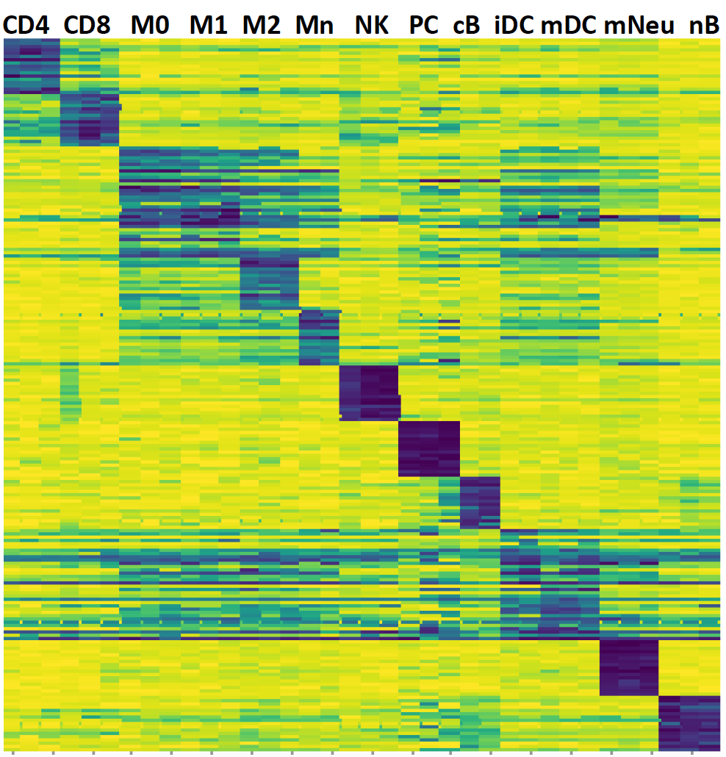
The 13 cell types Reference

Slide 6
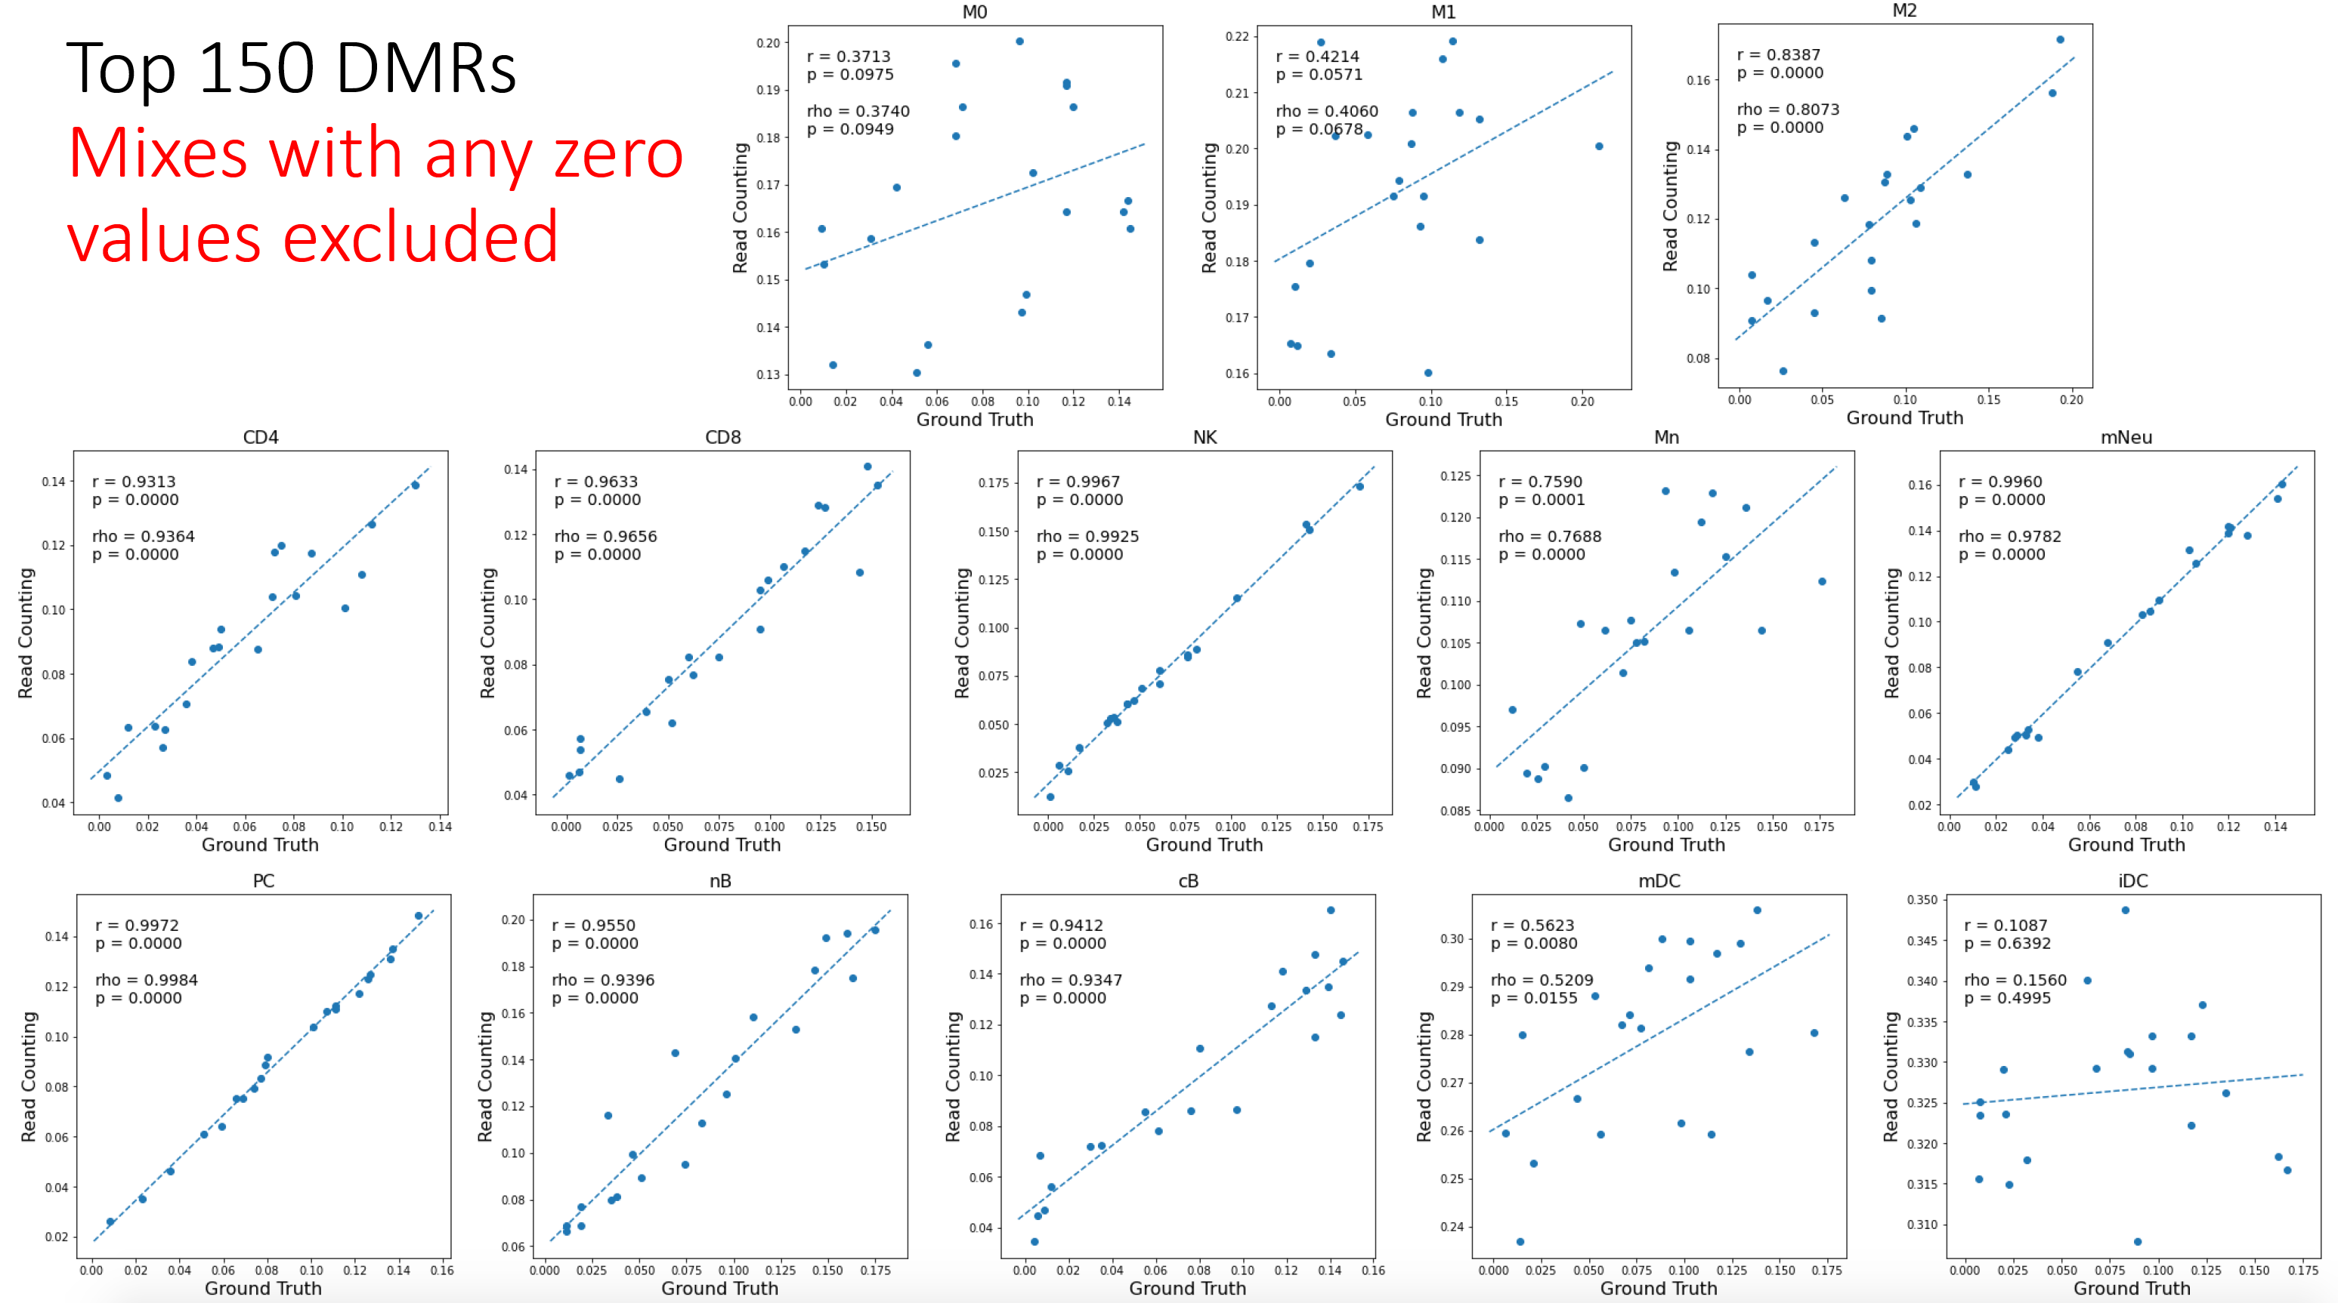
In Silico performance

Slide 7
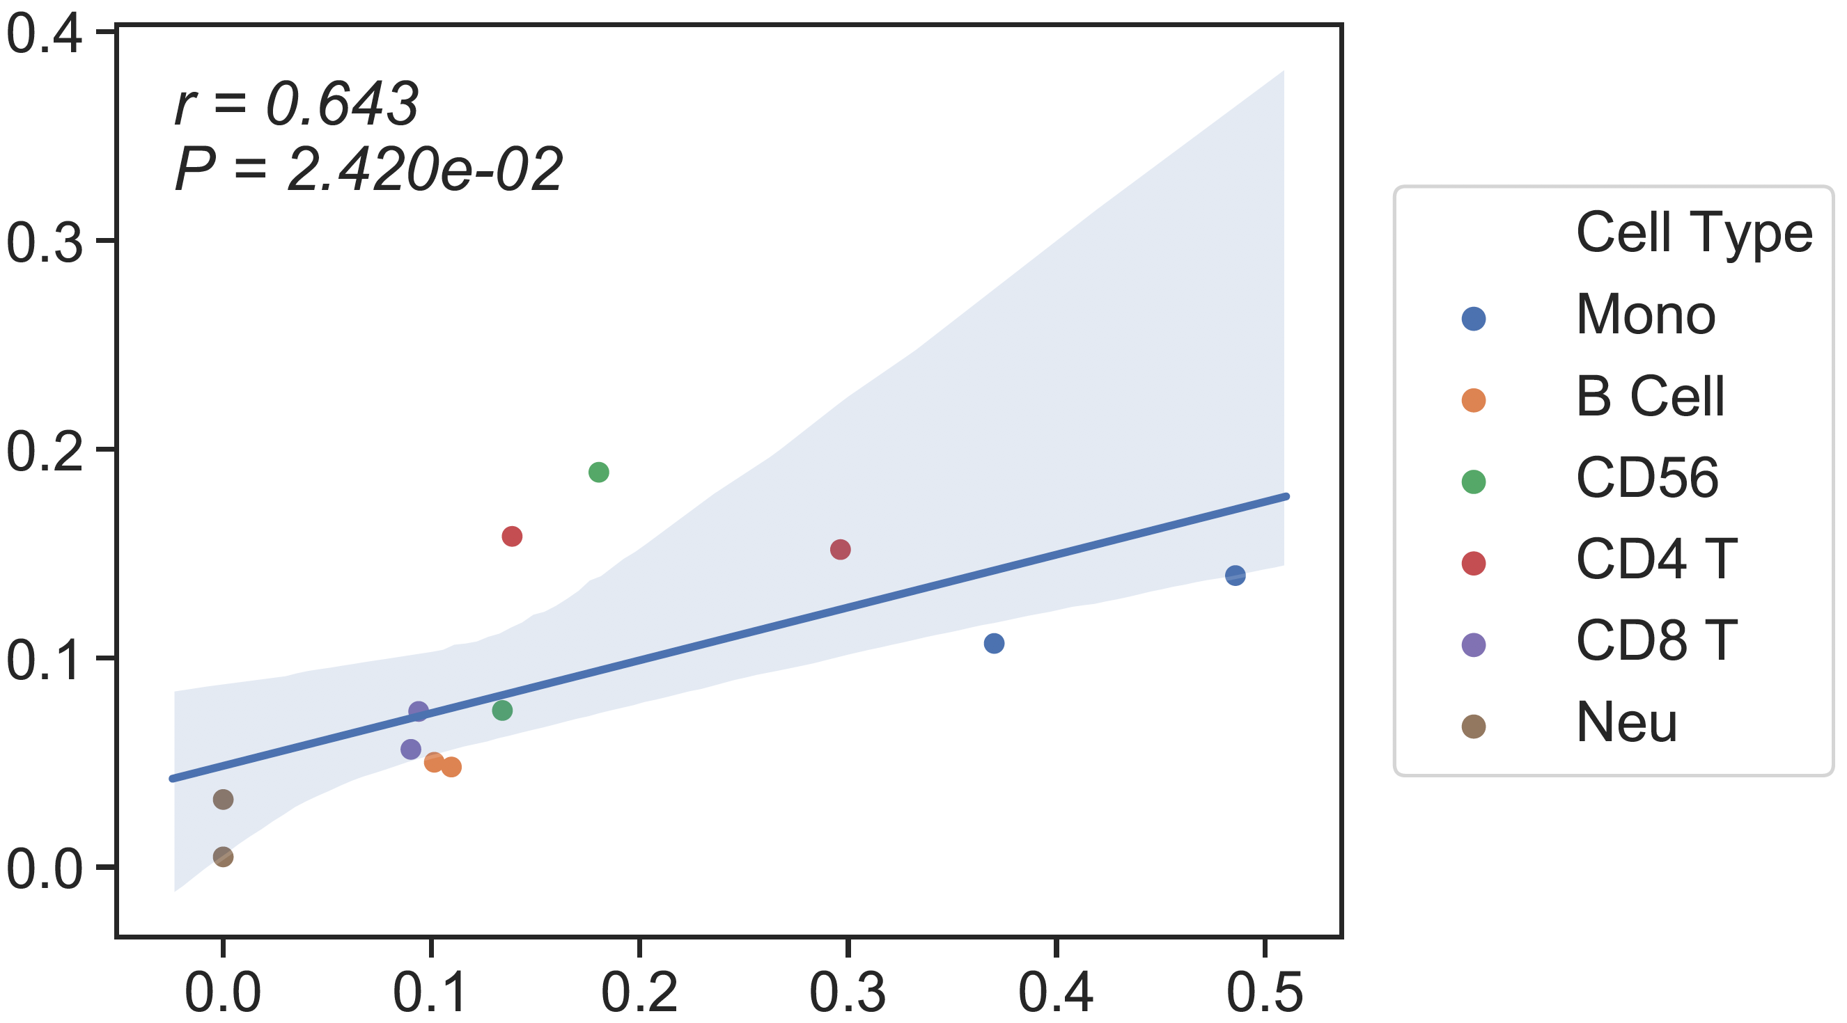
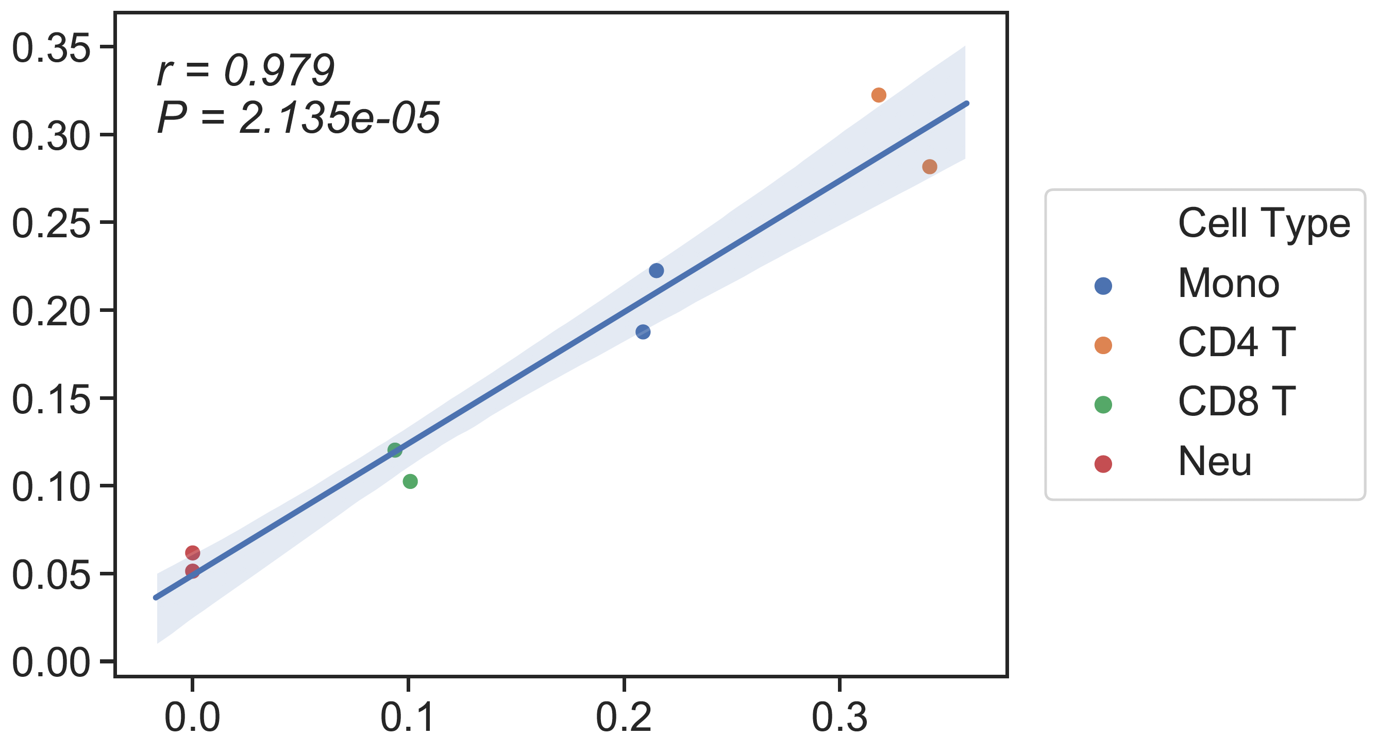
In silico performance shows that Mono is not doing great
As a naïve approach, I just combined Mono (Mn), M0, M1 and M2 of read counting estimation and the result is following:
Batch1
(Depth ~ 15x, input ~ 25ng)
Batch2
(Depth ~ 30x, input ~ 100ng)
13 cell types reference
(Predicted Mono = Mono+M0+M1+M2)
rho= 0.81
rho= 0.95
Flow cytometry
Flow cytometry

Slide 8
Summary
Mn does not show a good performance in in-silico mixture and performs poorly in the real bulk-PBMC
We need to generate more specific DMR for some cell types(Mn, M0, M1, M2, iDC and mDC).
The current 13 cell types reference has 150 DMR for each cell type. Probably we need to take subset of those for the noisy ones.
As we discussed before, we may use the in-silico mixtures to generate an optimal reference for each cell type (training on the in-silico mixtures)

Slide 9
Whole Blood

Slide 10
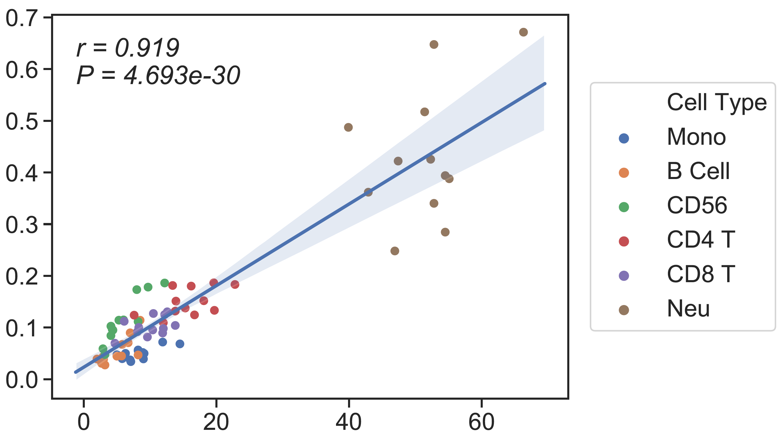
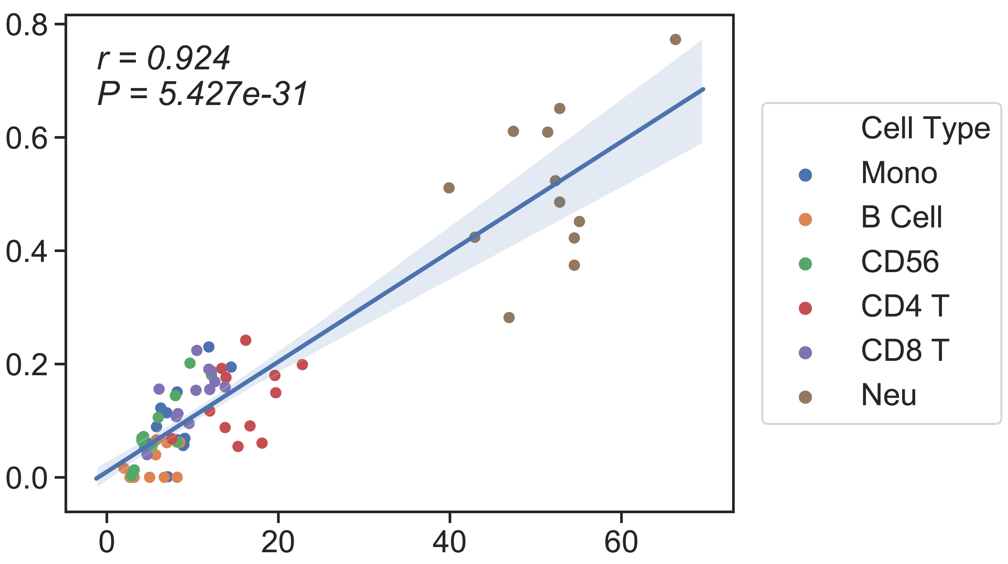
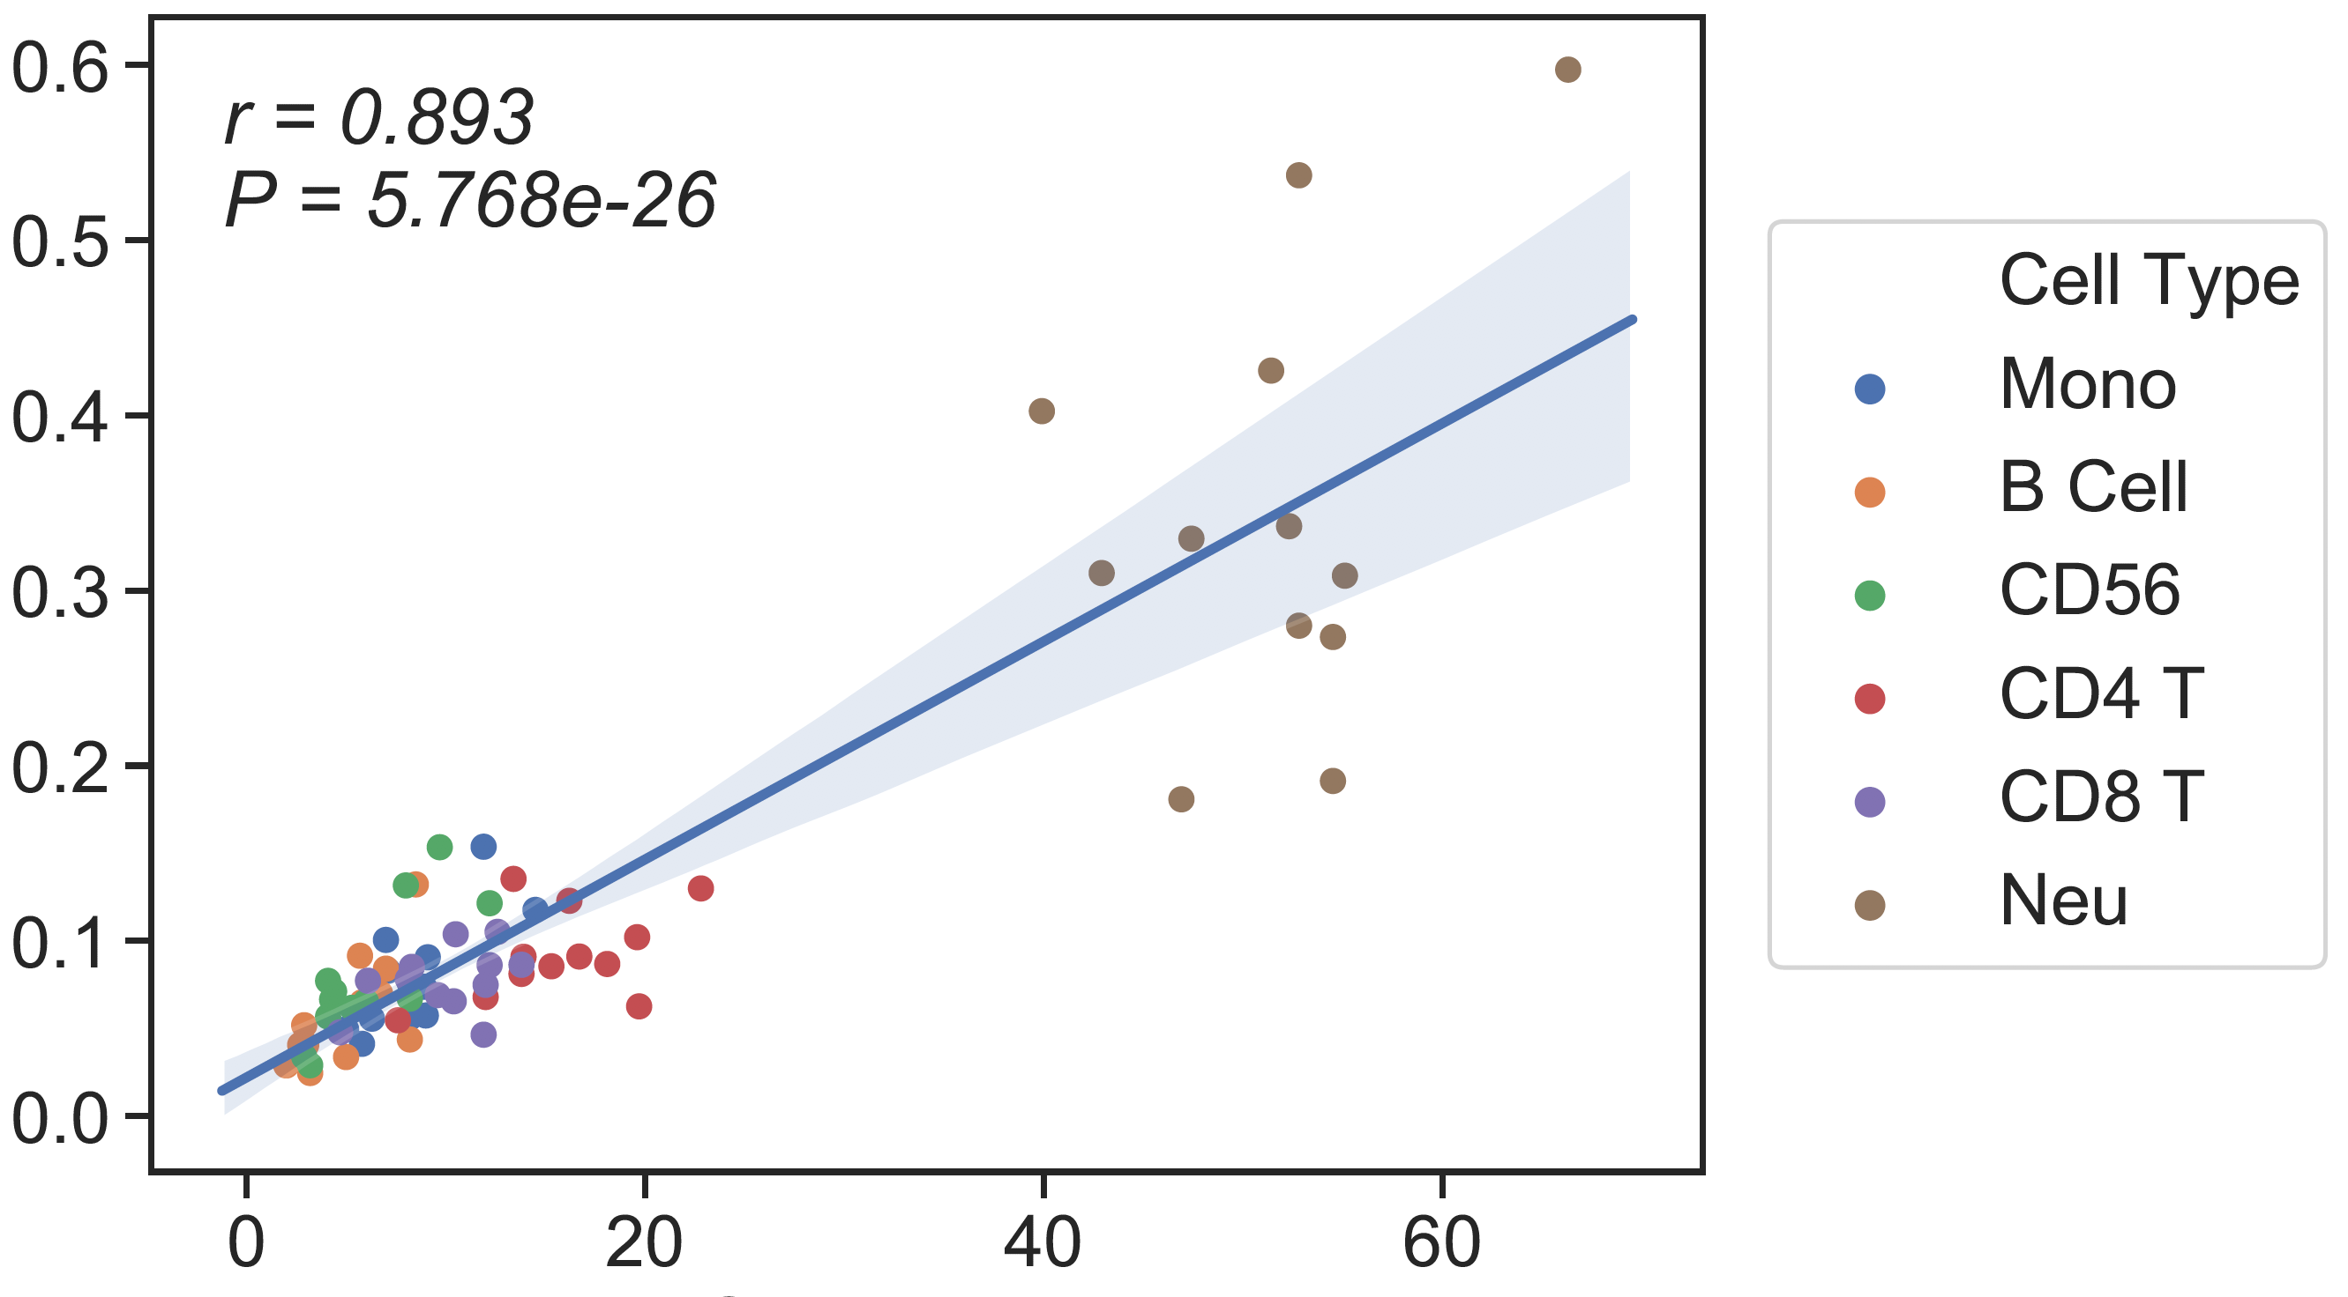
CBC/Clin Flow
13 cell type Ref
6cell type Ref
Candace’s SM
CSx
Absolute Read Counting
rho = 0.81
rho = 0.8
rho = 0.82
CBC/Clin Flow
CBC/Clin Flow
CBC/Clin Flow

Slide 11
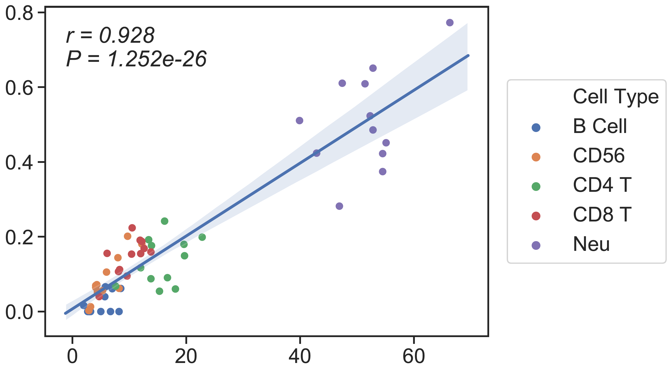
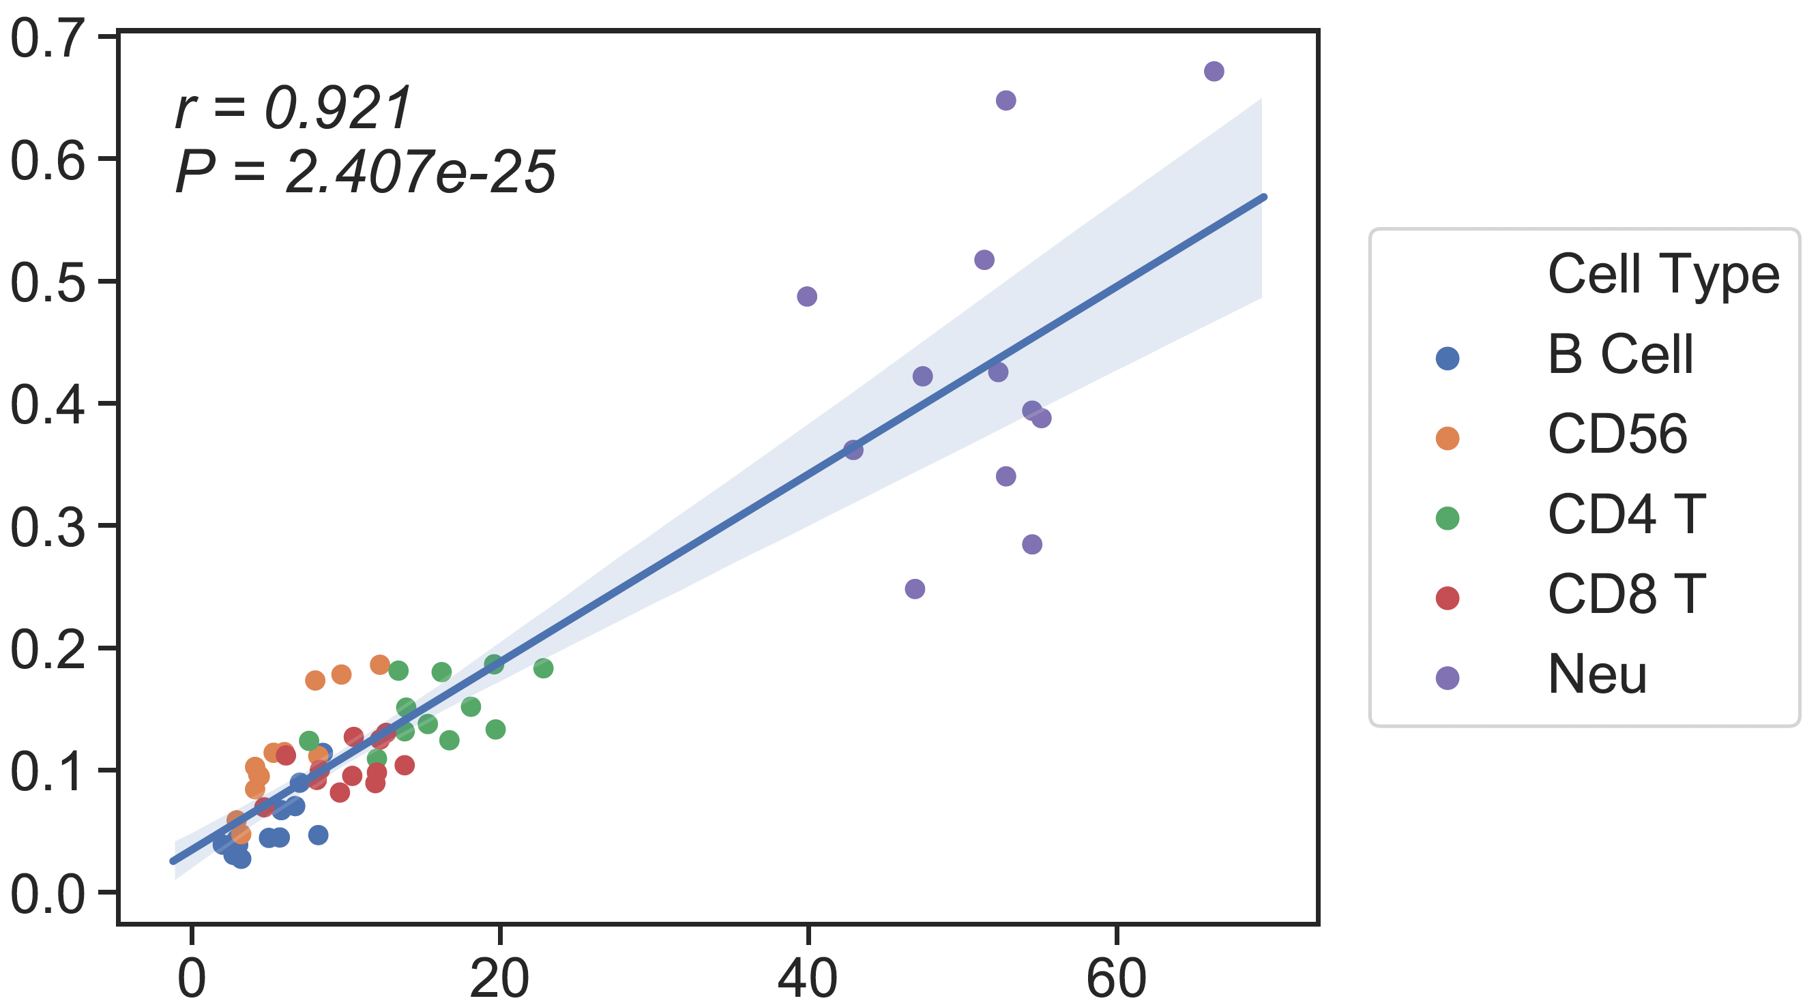
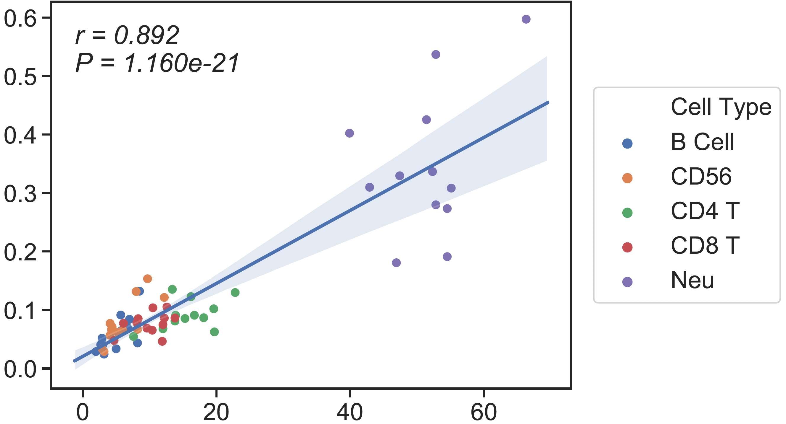
CBC/Clin Flow
13 cell type Ref
6cell type Ref
Candace’s SM
CSx
Absolute Read Counting
rho = 0.89
rho = 0.83
rho = 0.84
CBC/Clin Flow
CBC/Clin Flow
CBC/Clin Flow

Slide 12
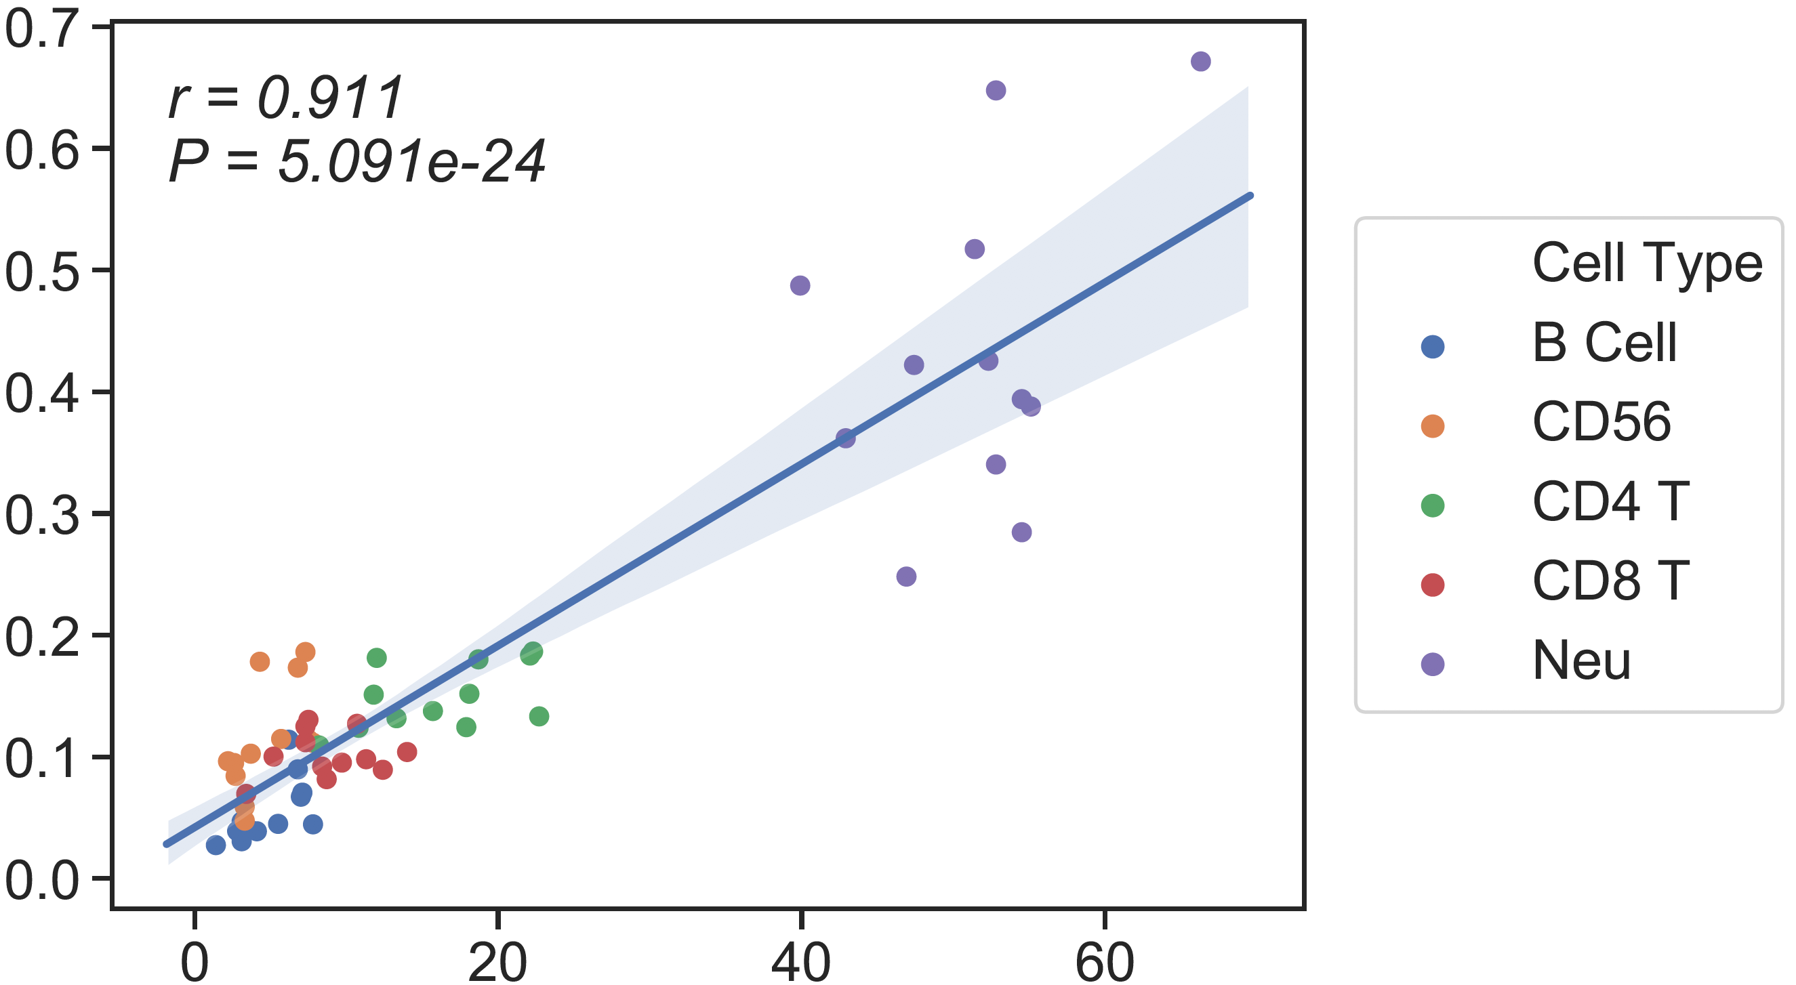
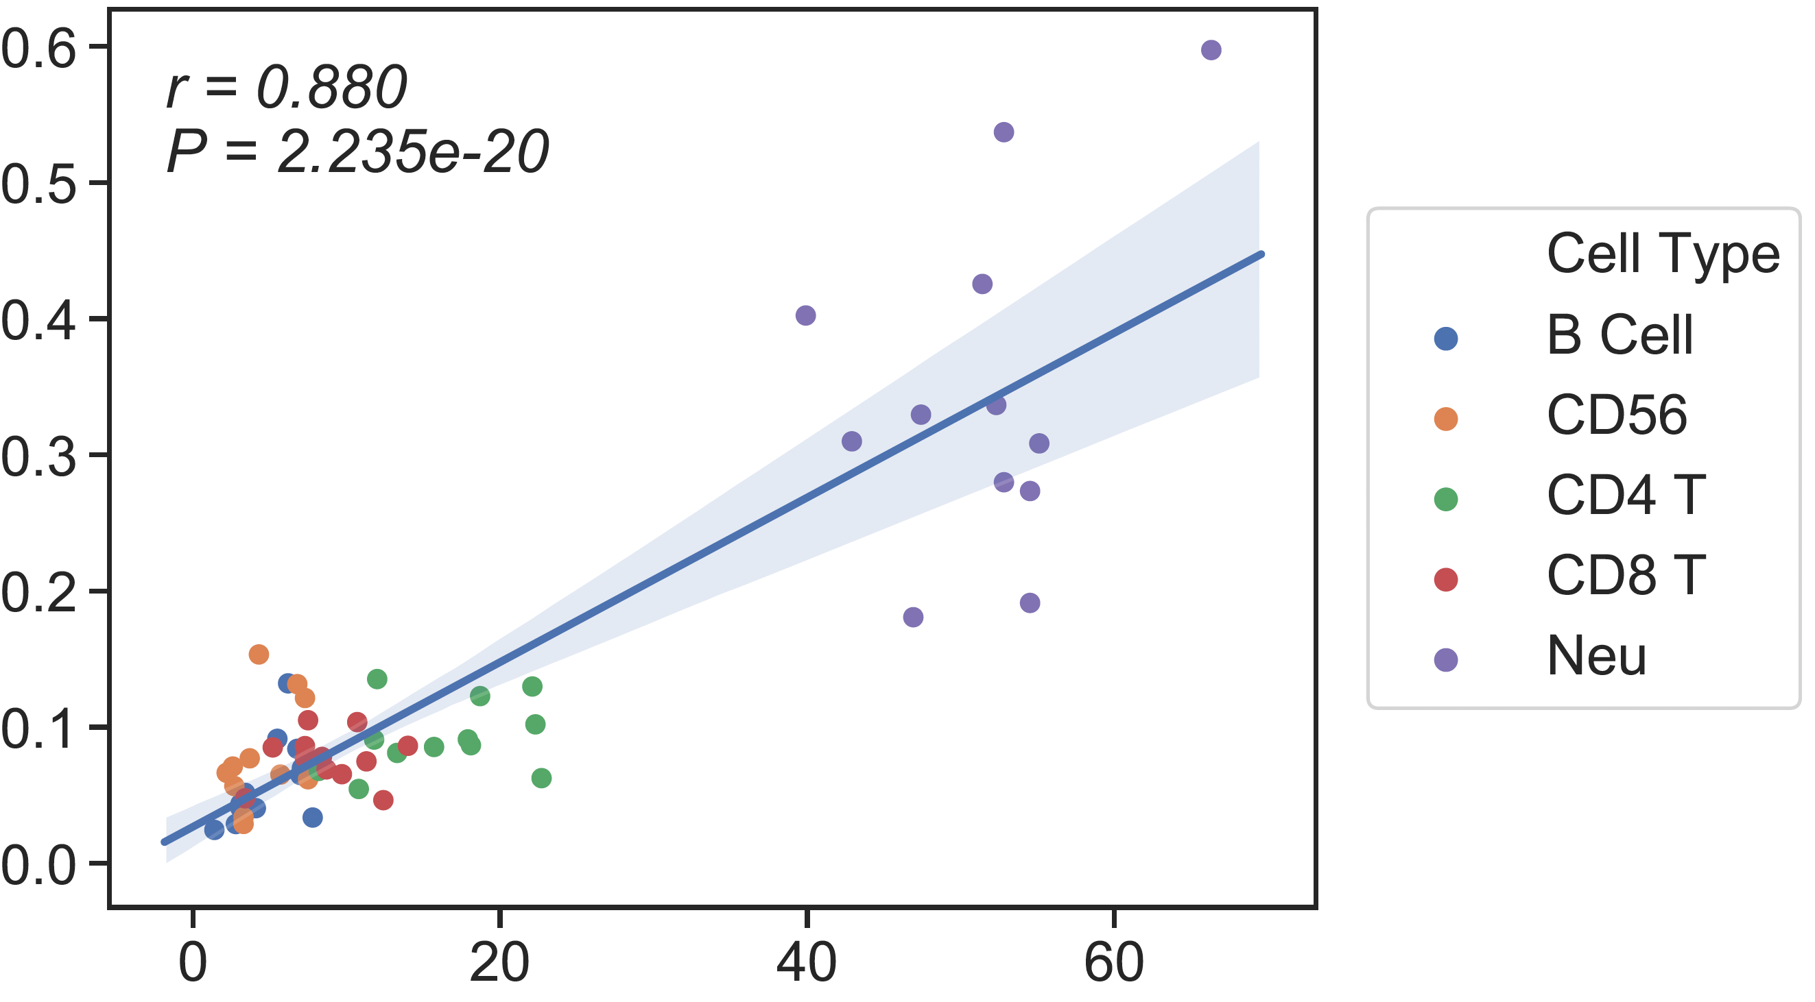

CBC/CyTOF
13 cell type Ref
6cell type Ref
Candace’s SM
CSx
Absolute Read Counting
rho = 0.82
rho = 0.72
rho = 0.78
CBC/CyTOF
CBC/CyTOF
CBC/CyTOF

Slide 13
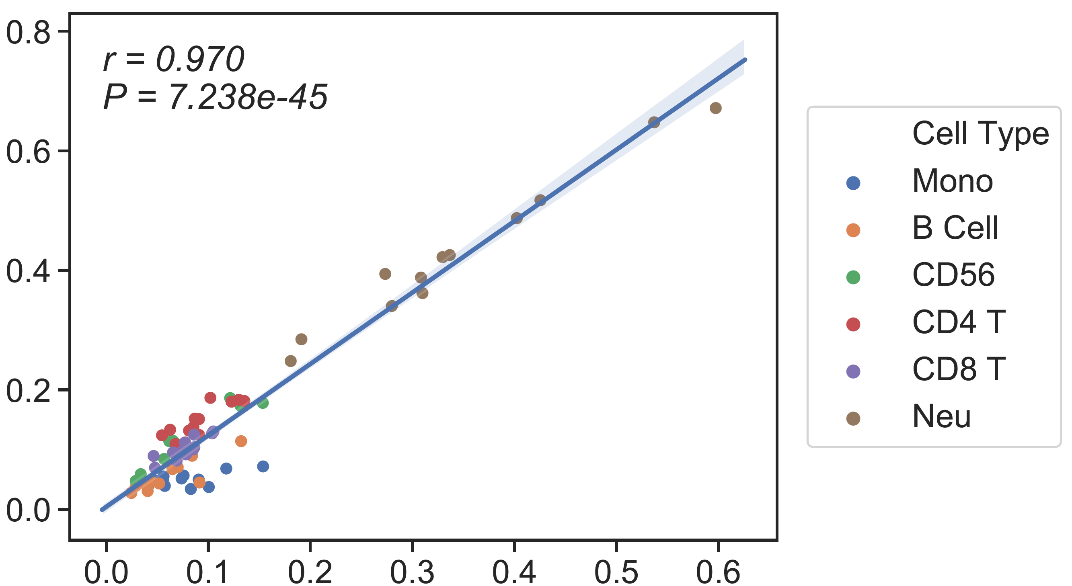
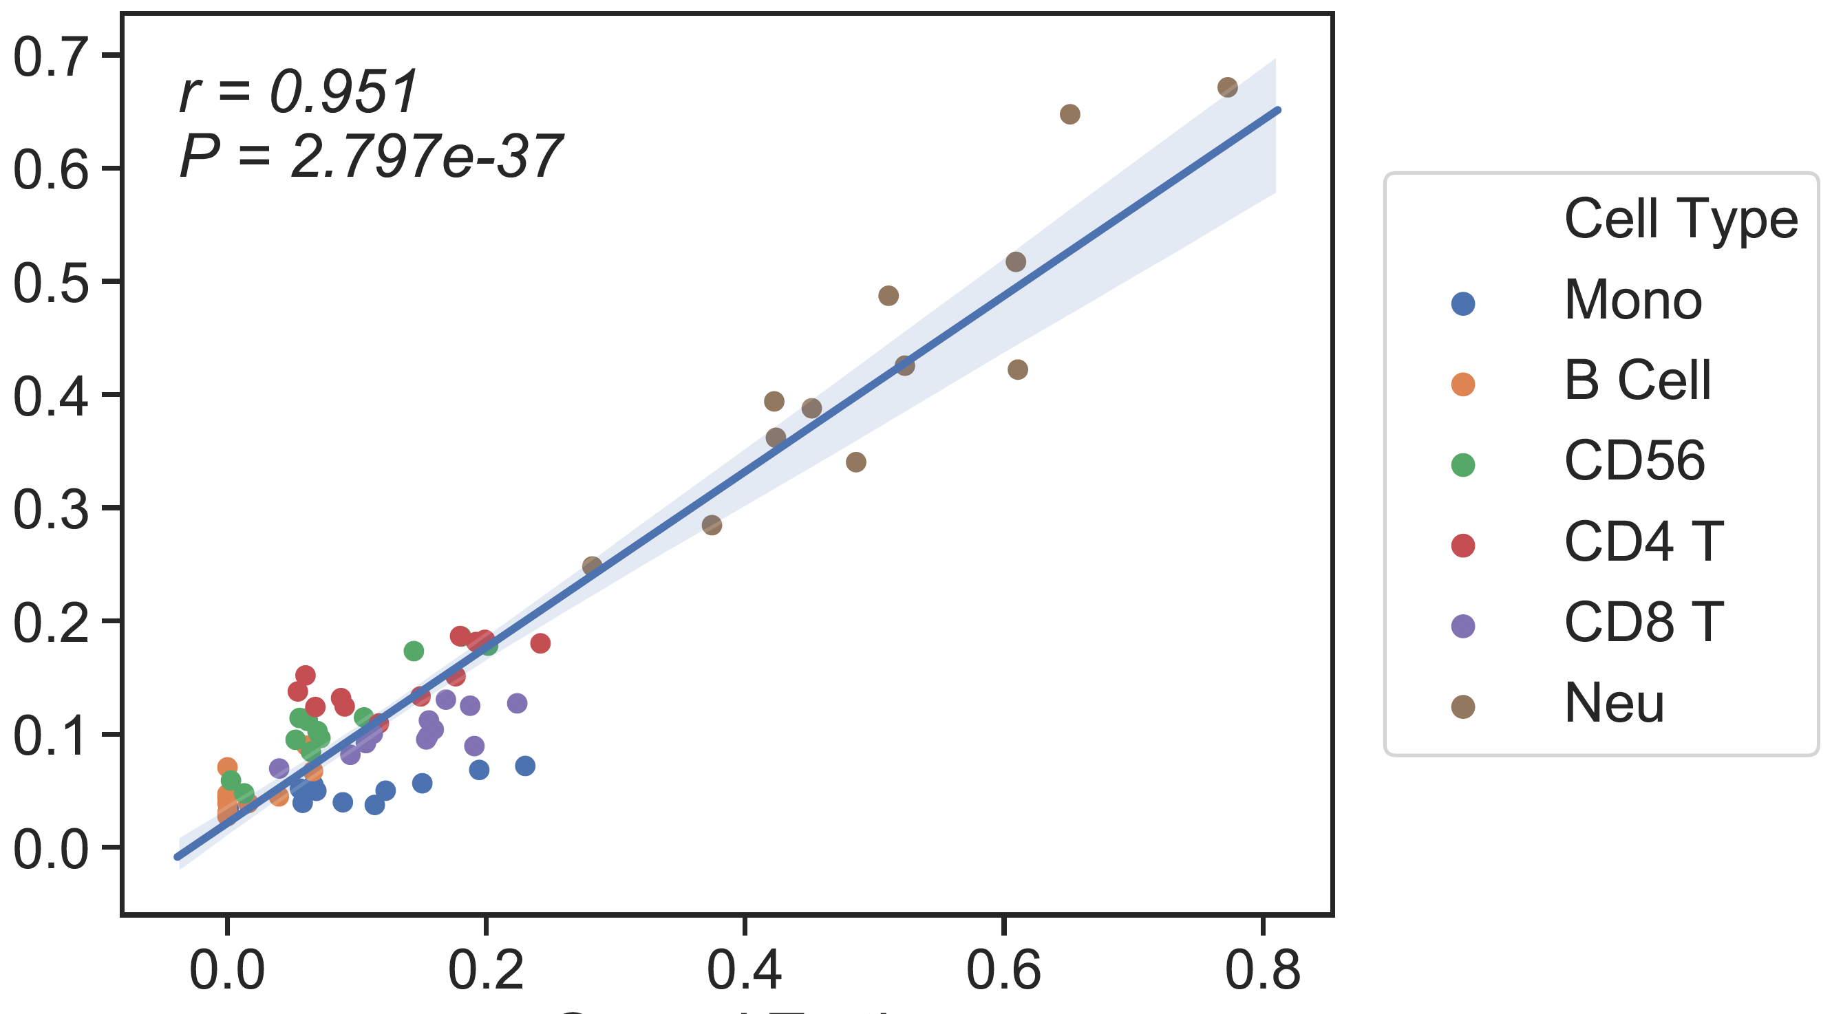
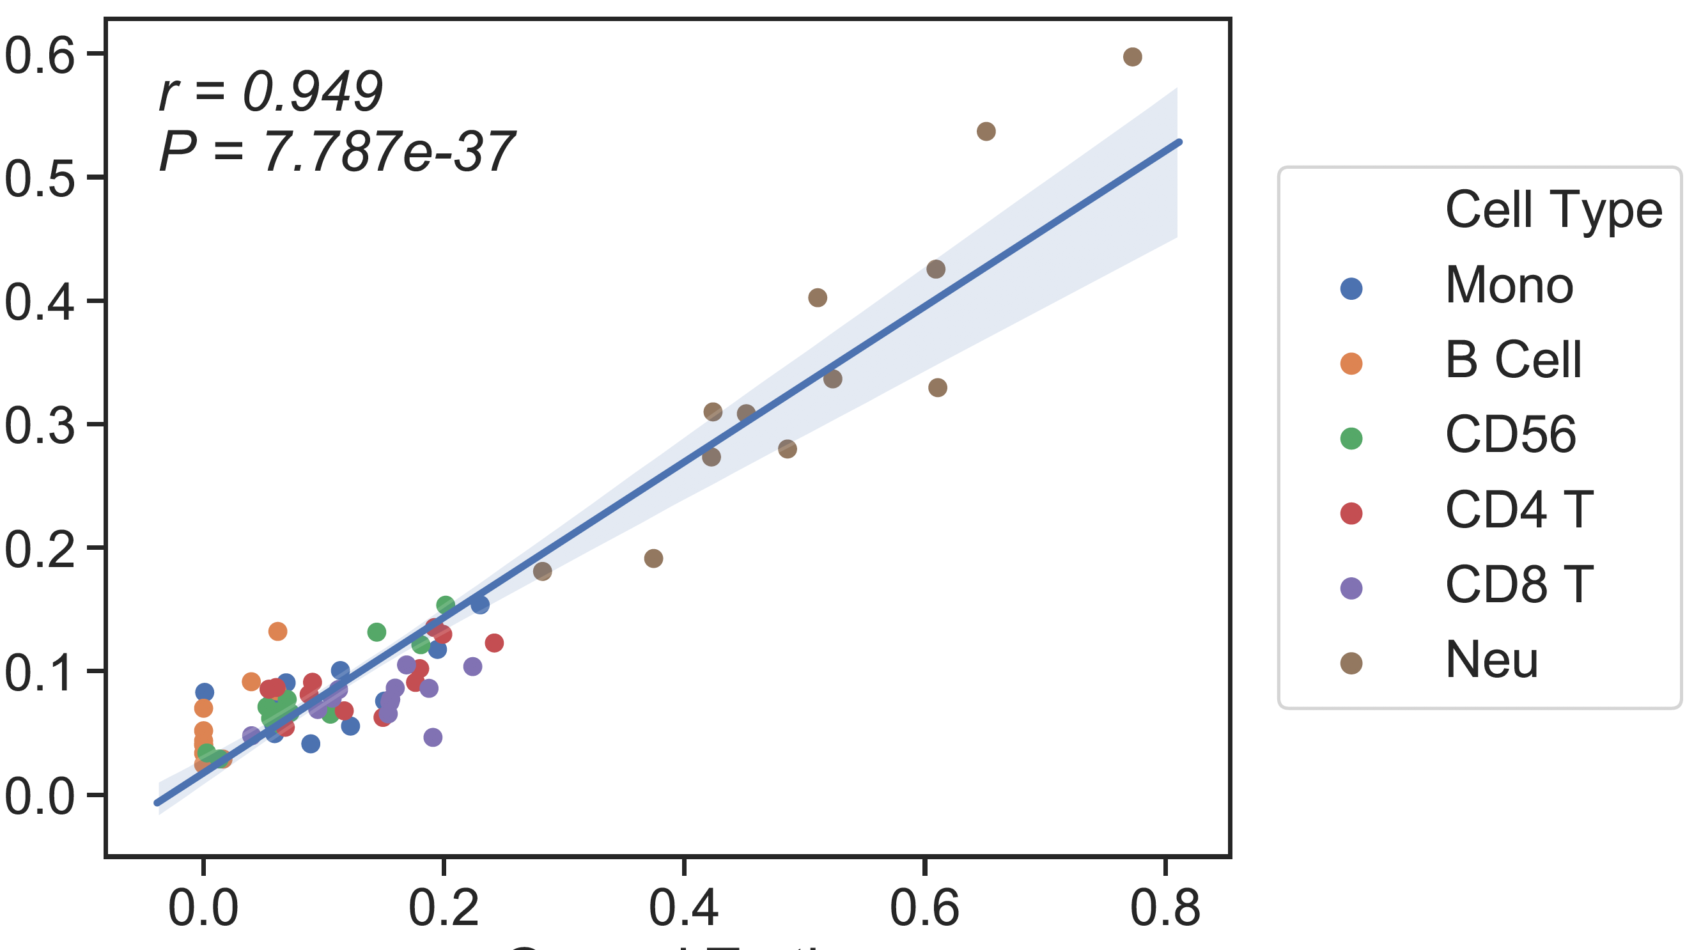
13cell type ref
6 cell type ref
rho= 0.79
rho= 0.79
rho= 0.8
6 cell type ref
Candace’s SM (CSx)
Candace’s SM (CSx)

Slide 14
Accomando’s whole blood dataset
Candace’s SM
Our SM
CSx
CSx

Slide 15
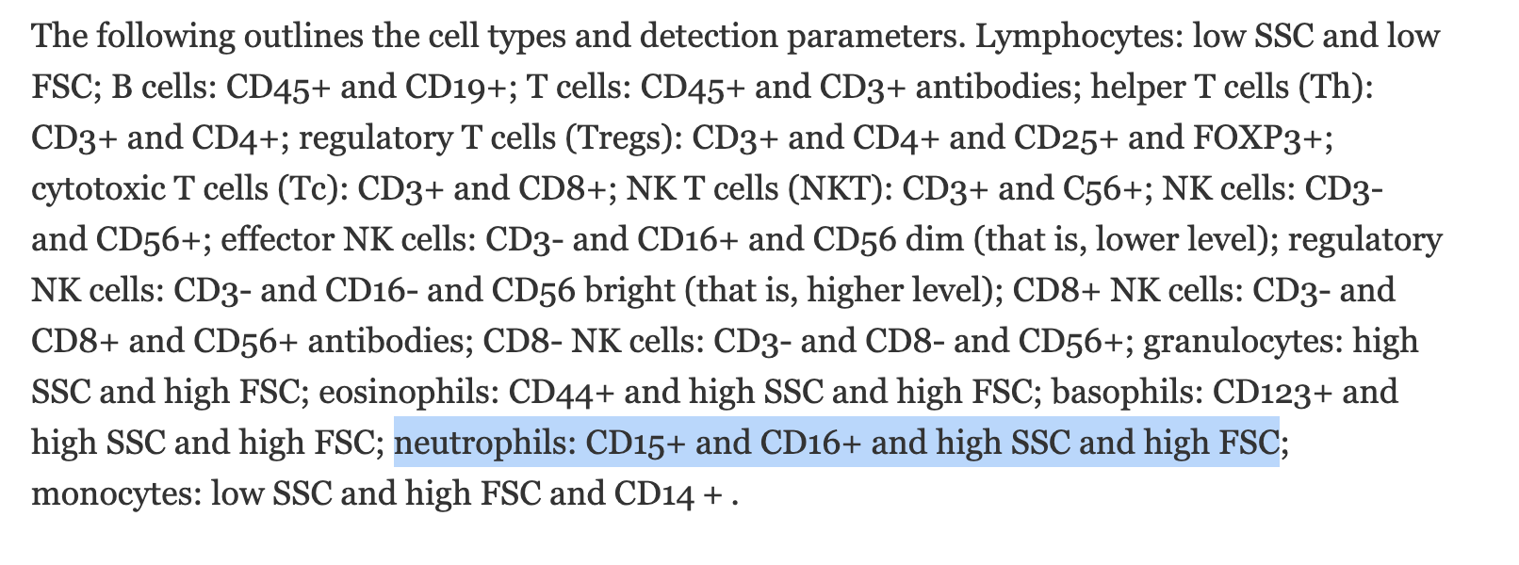
Accomando’s FACS

Slide 16
Plan
Develop reference without M0, M1 and M2
Study the ground truth scaling and combining process

Slide 17
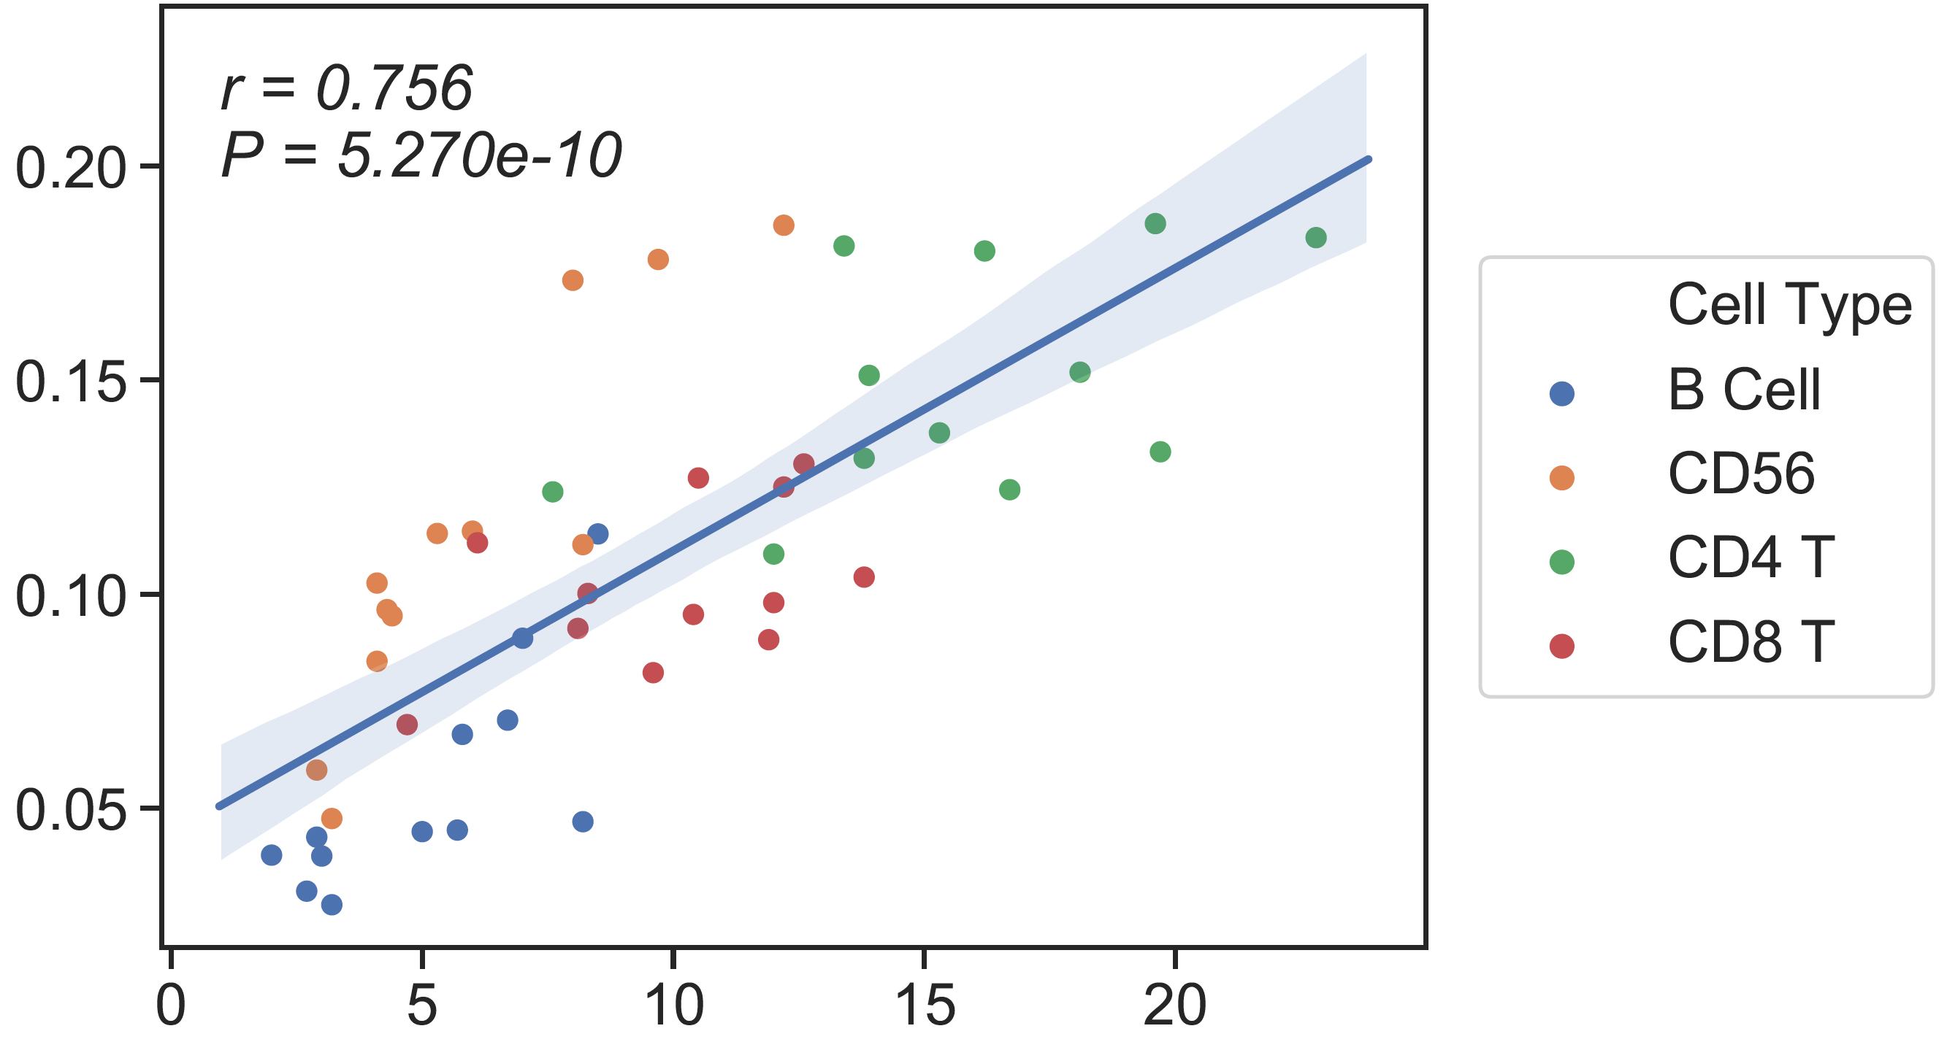
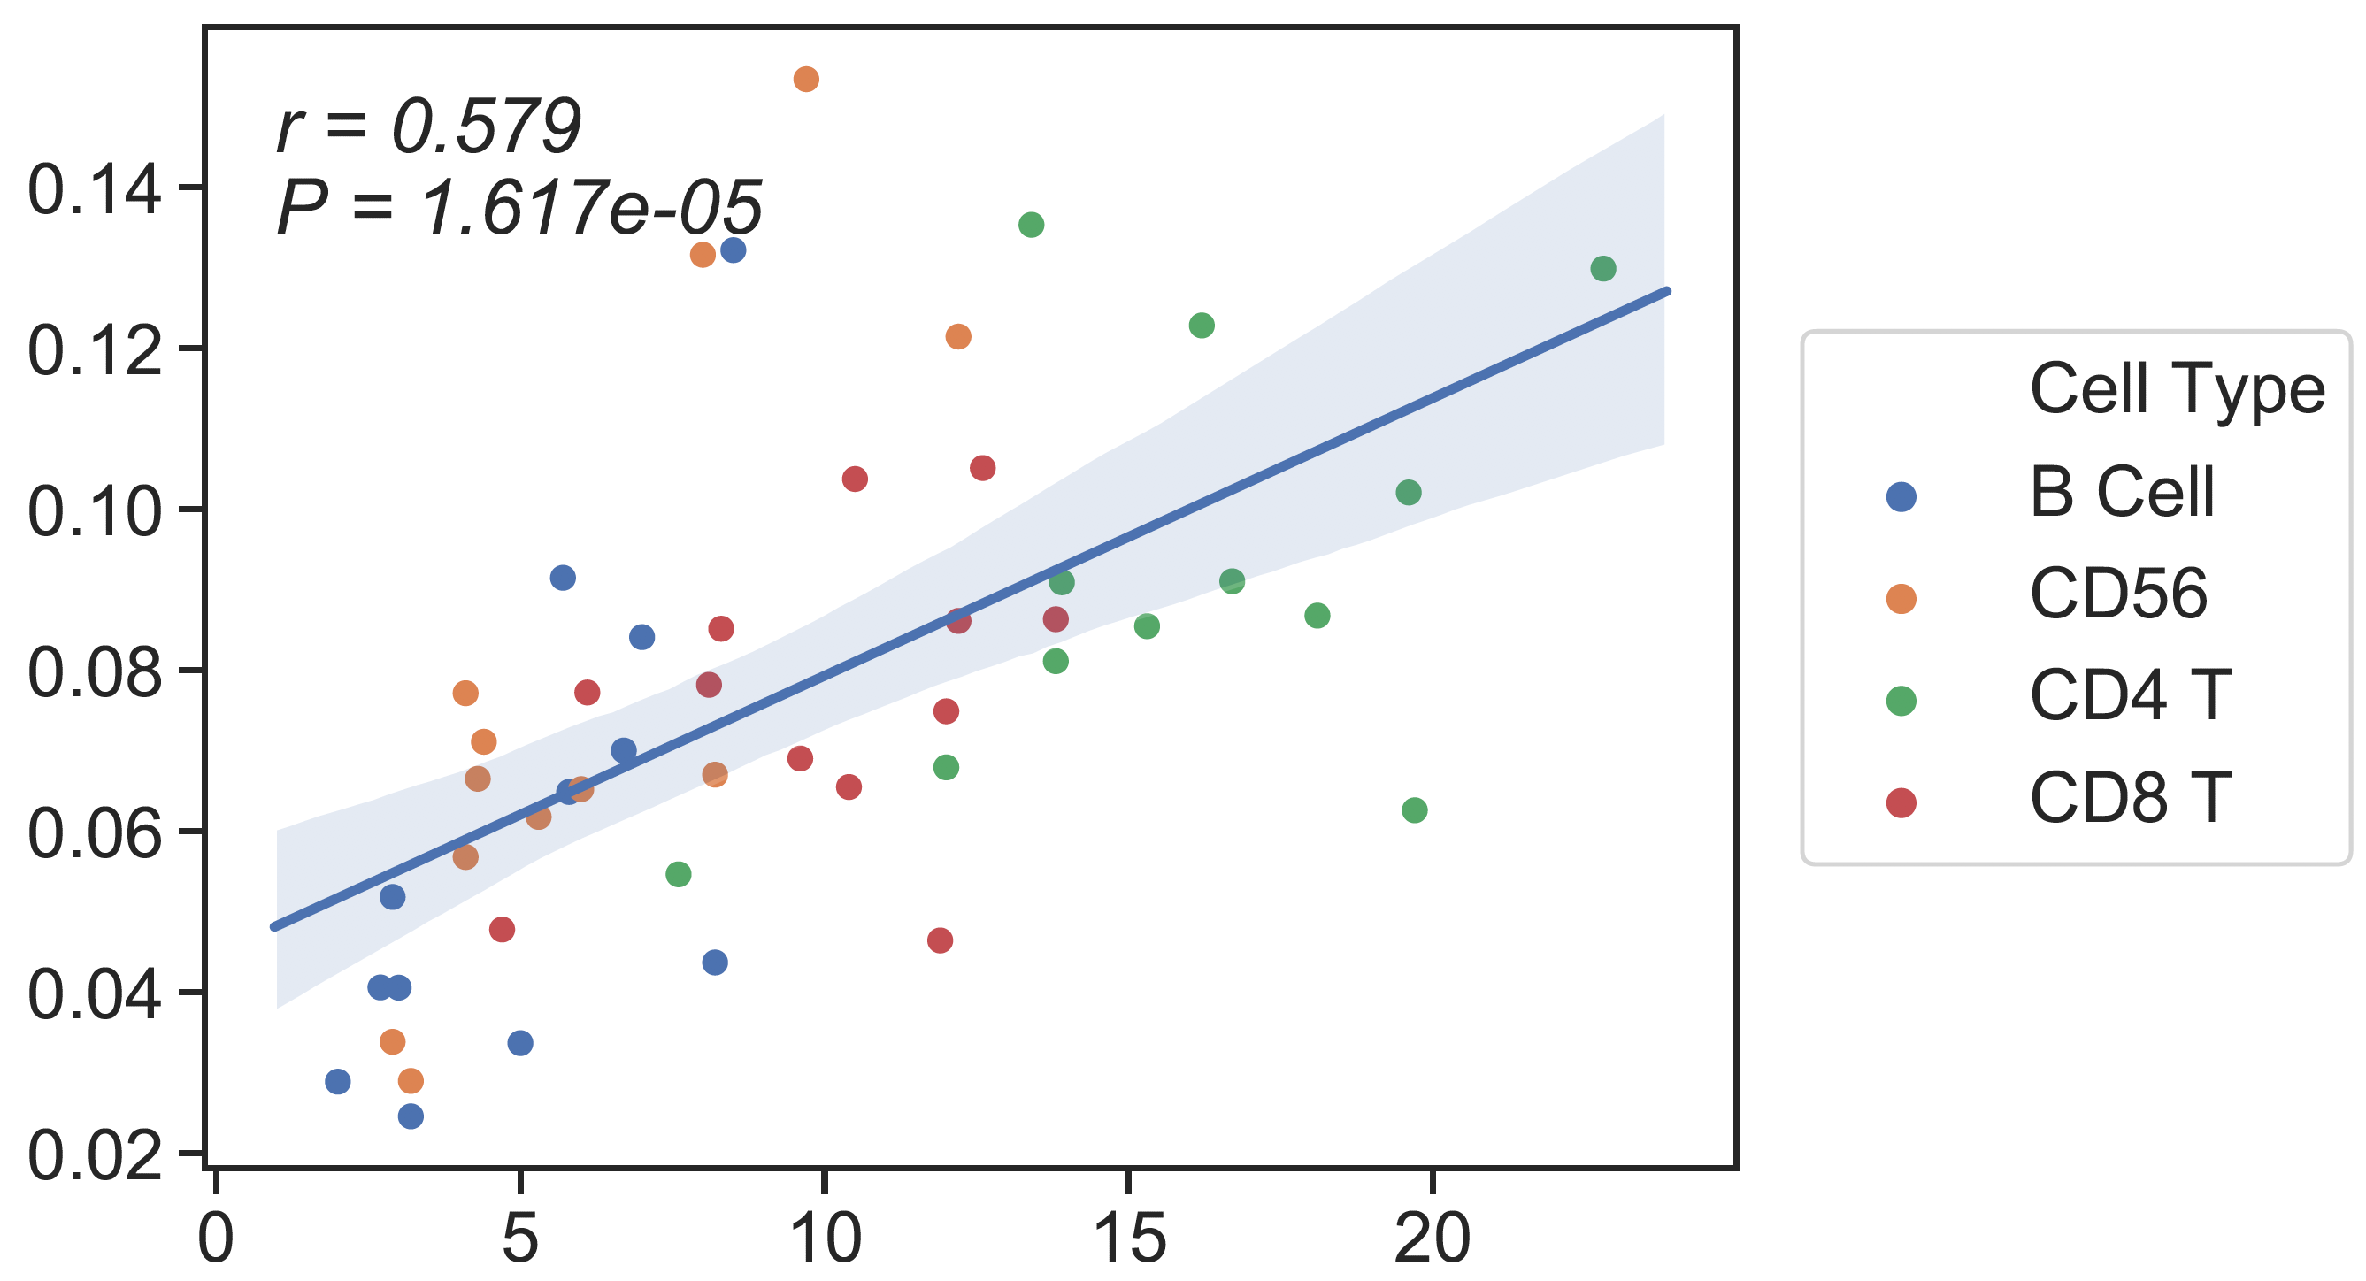
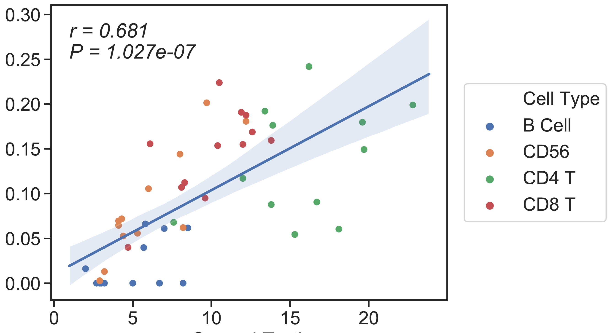
CBC/Clin Flow
13 cell type Ref
6cell type Ref
Candace’s SM
CSx
Absolute Read Counting
rho = 0.8
rho = 0.68
rho = 0.7
CBC/Clin Flow
CBC/Clin Flow
CBC/Clin Flow

Slide 18
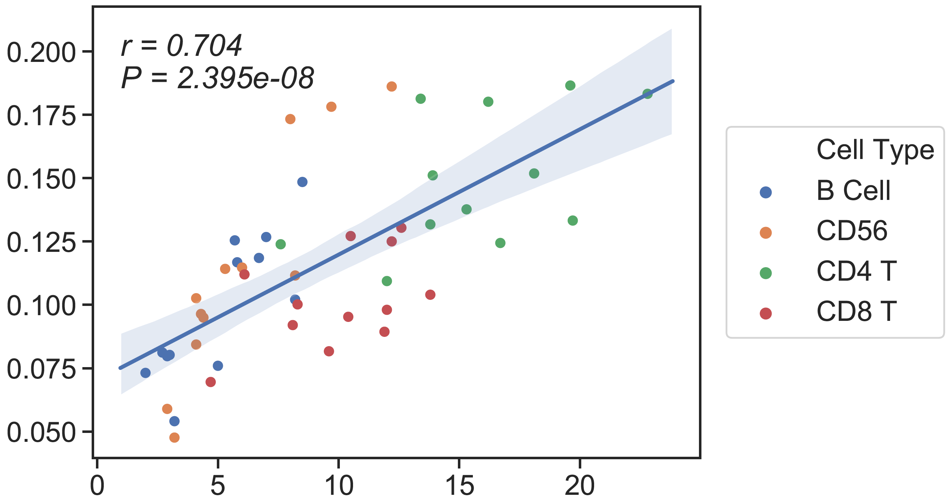
CBC/Clin Flow
13 cell type Ref
6cell type Ref
Candace’s SM
CSx
Absolute Read Counting
rho = 0.75
rho = 0.68
rho = 0.7
CBC/Clin Flow
CBC/Clin Flow
CBC/Clin Flow
Notes:
13 ct ref: B cell=nb+cb

Slide 19
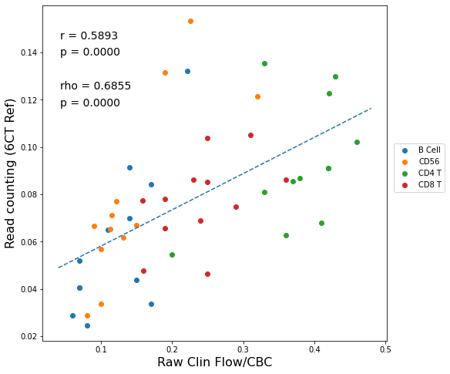
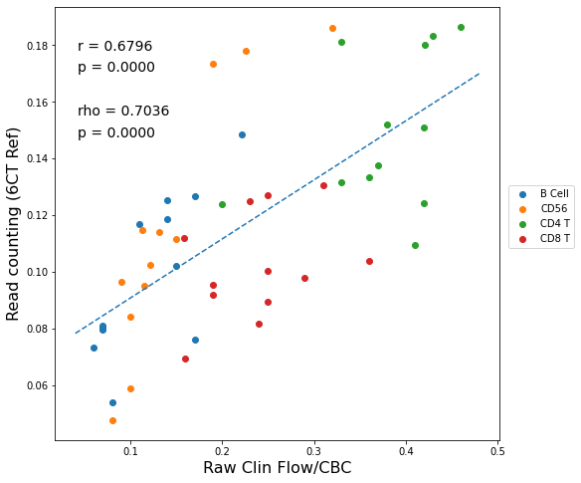
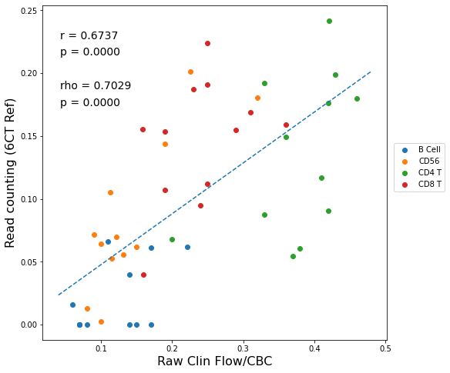
Raw Clin Flow
13 cell type Ref
6cell type Ref
Candace’s SM
CSx
Absolute Read Counting
CBC/Clin Flow
CBC/Clin Flow
CBC/Clin Flow
Notes:
13 ct ref: B cell=nb+cb

Slide 20
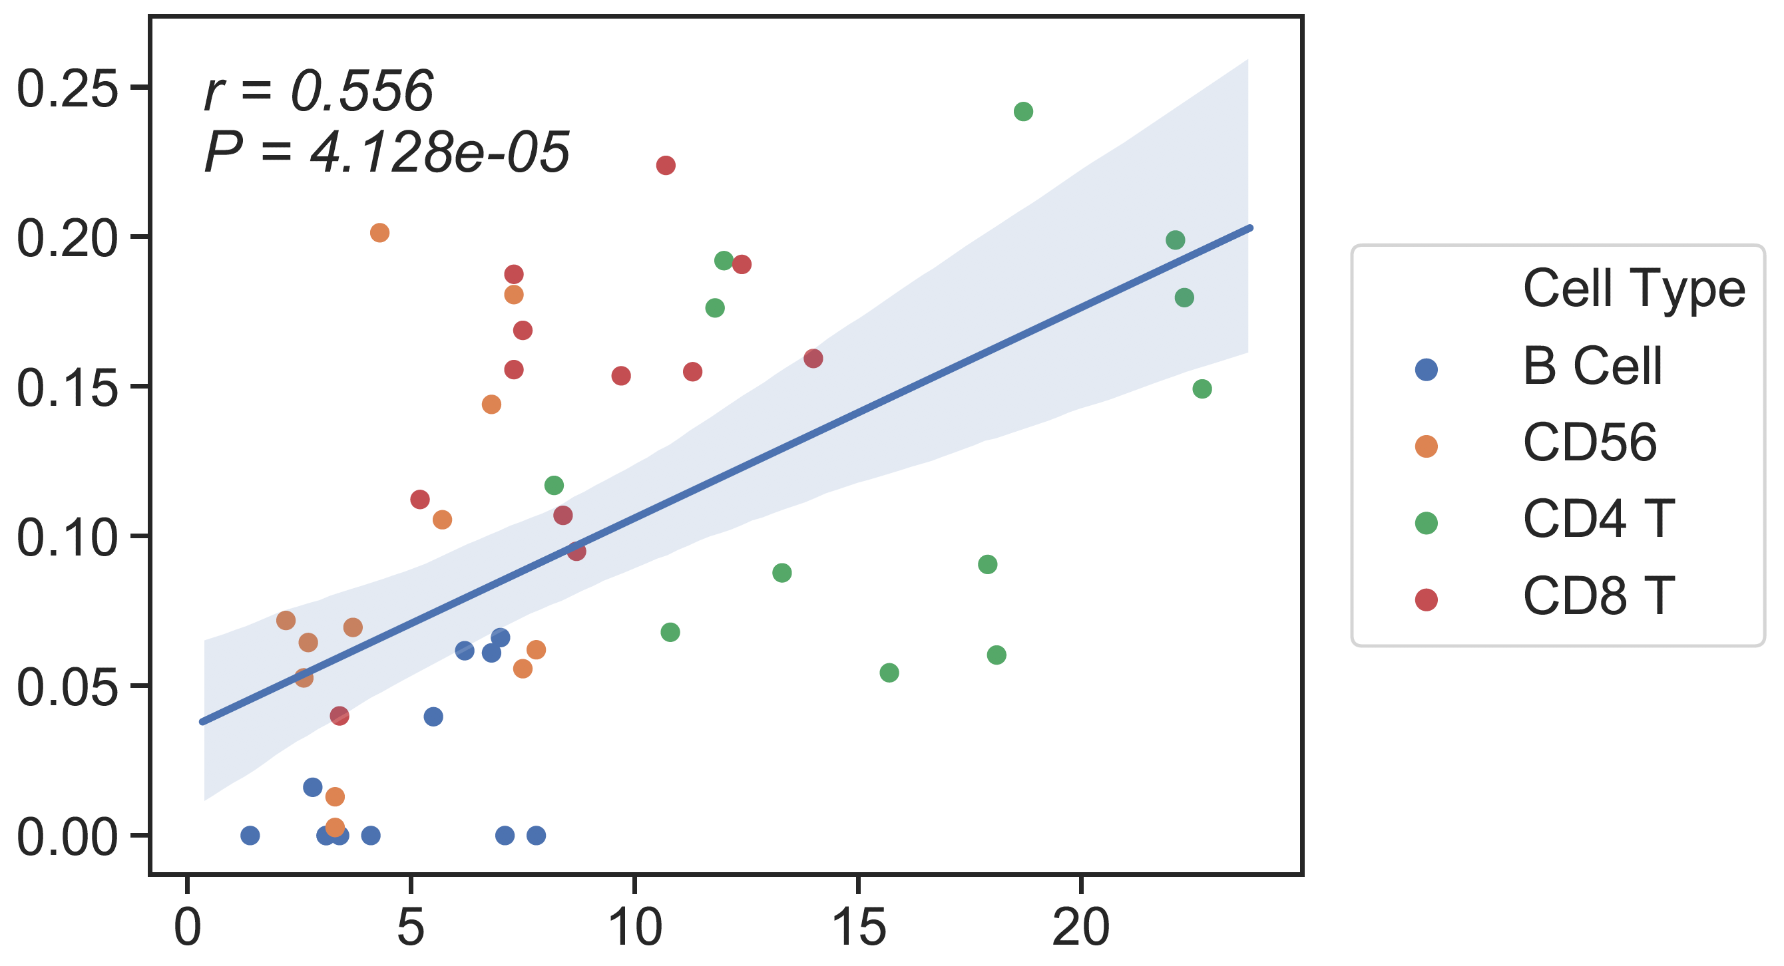
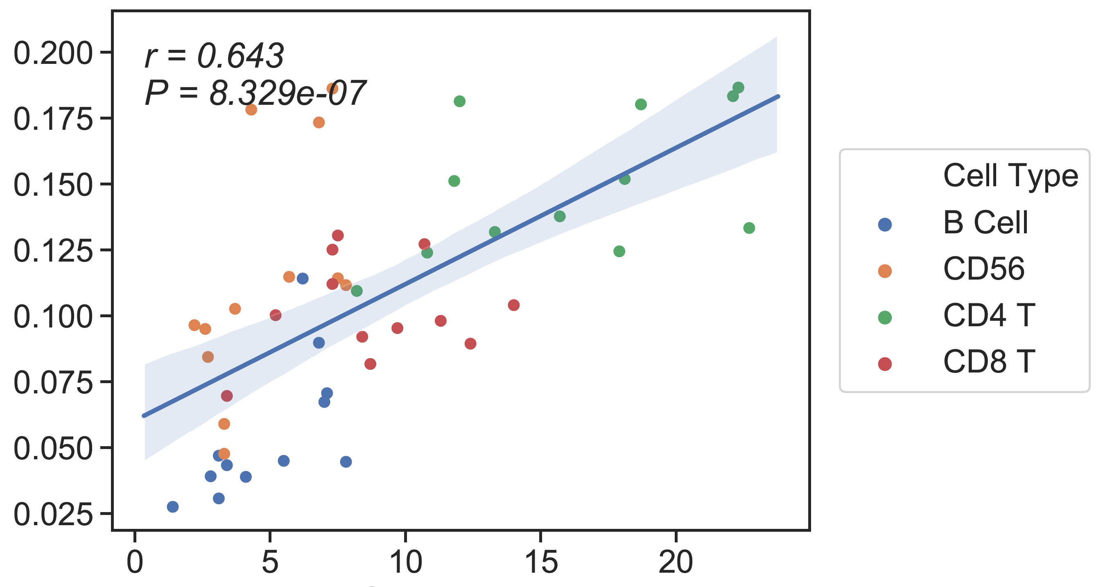
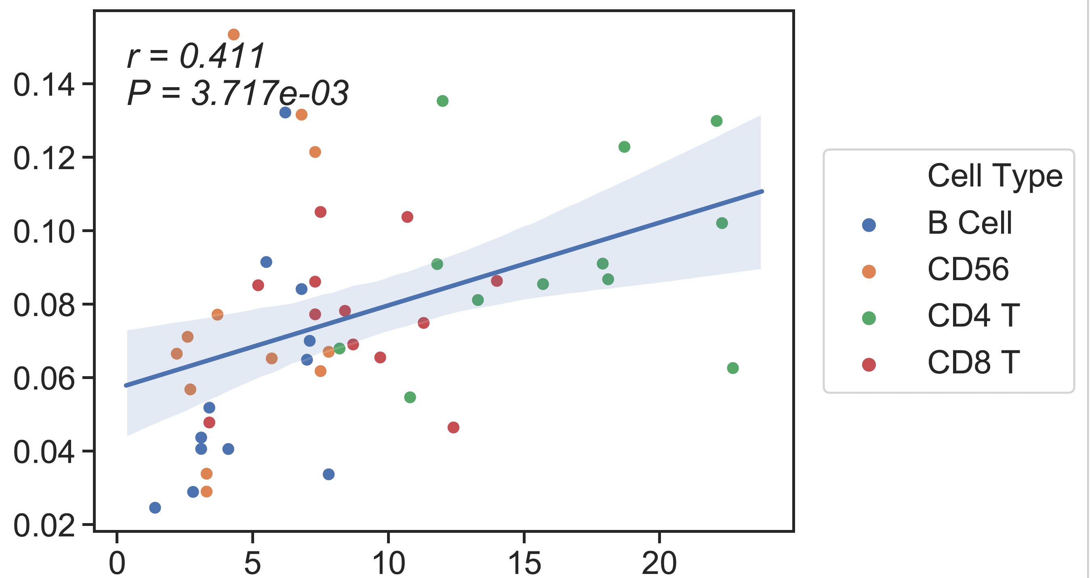
CBC/CyTOF
13 cell type Ref
6cell type Ref
Candace’s SM
Absolute Read Counting
CSx
rho = 0.66
rho = 0.48
rho = 0.59
CBC/CyTOF
CBC/CyTOF
CBC/CyTOF

Slide 21
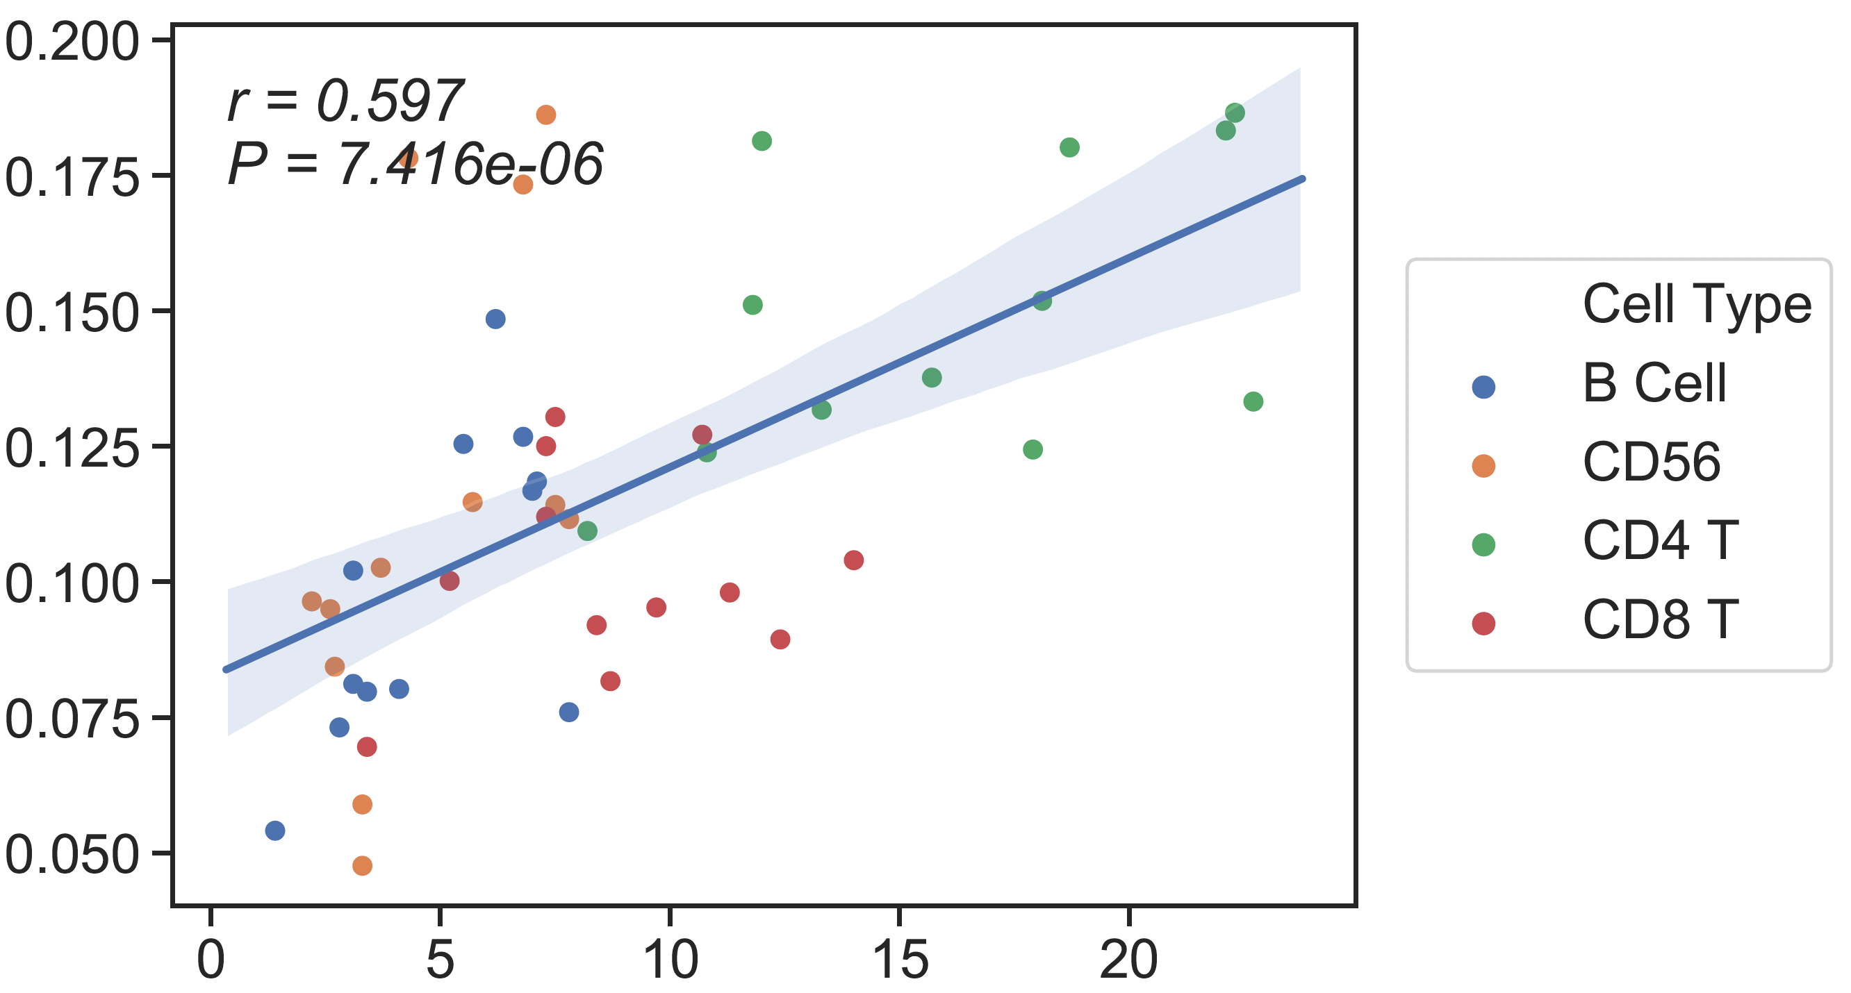
CBC/CyTOF
13 cell type Ref
6cell type Ref
Candace’s SM
Absolute Read Counting
CSx
rho = 0.596
rho = 0.48
rho = 0.59
CBC/CyTOF
CBC/CyTOF
CBC/CyTOF
Notes:
13 ct ref: B cell=nb+cb

Slide 22
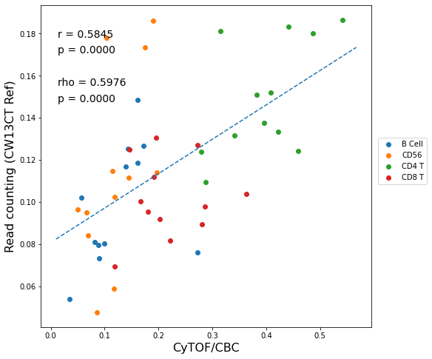
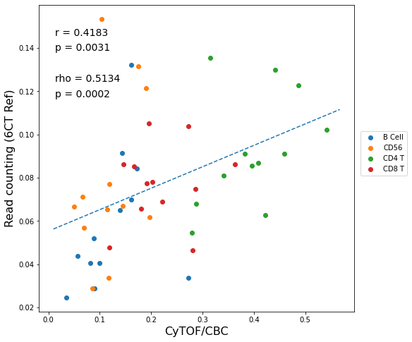
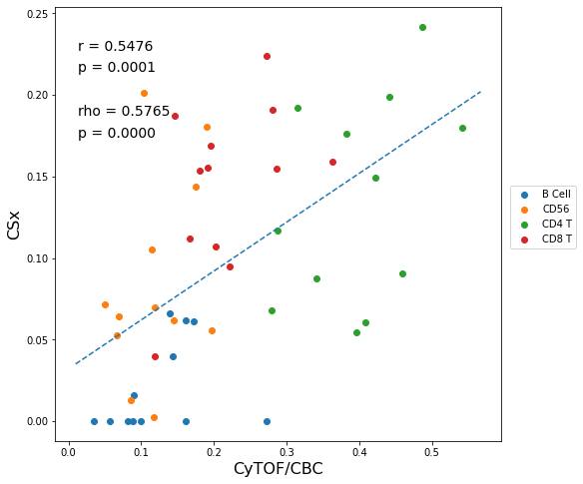
CBC/CyTOF
13 cell type Ref
6cell type Ref
Candace’s SM
Absolute Read Counting
CSx
CBC/CyTOF
CBC/CyTOF
CBC/CyTOF
Notes:
13 ct ref: B cell=nb+cb

Slide 25
B cell=nb+cb
13 cell type Ref
Absolute Read Counting
rho = 0.75
rho = 0.596
CBC/Clin Flow
Cytof

Slide 26
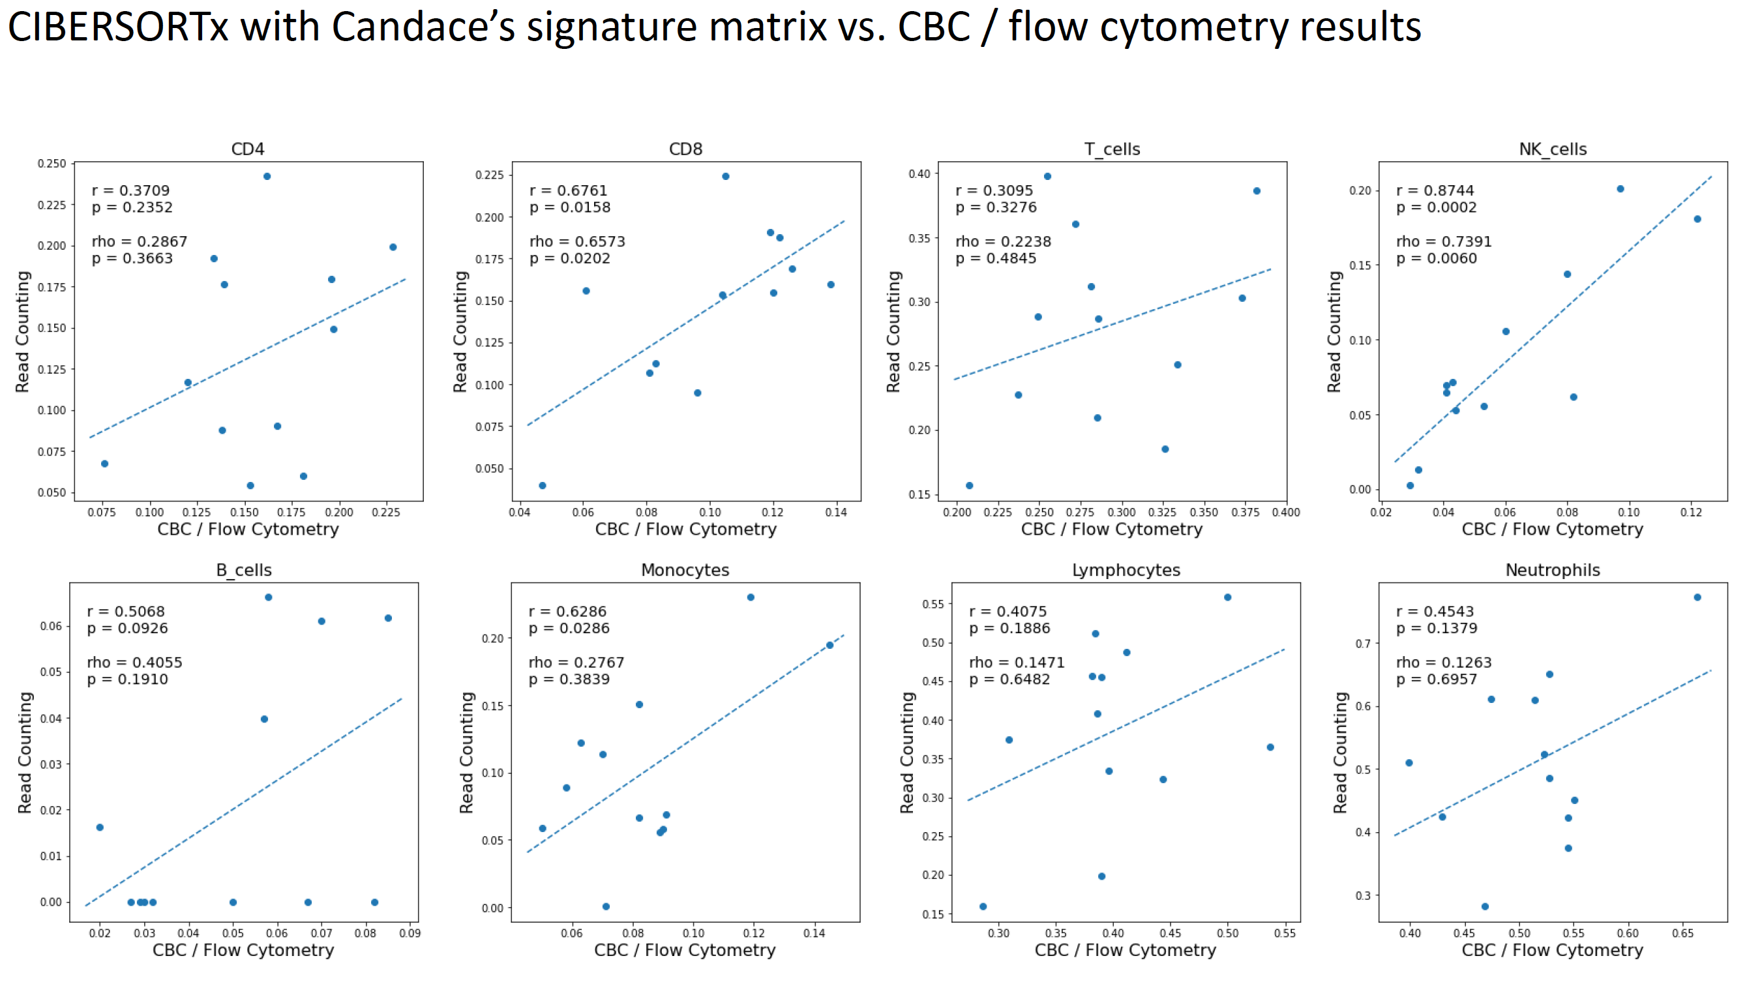

Slide 27
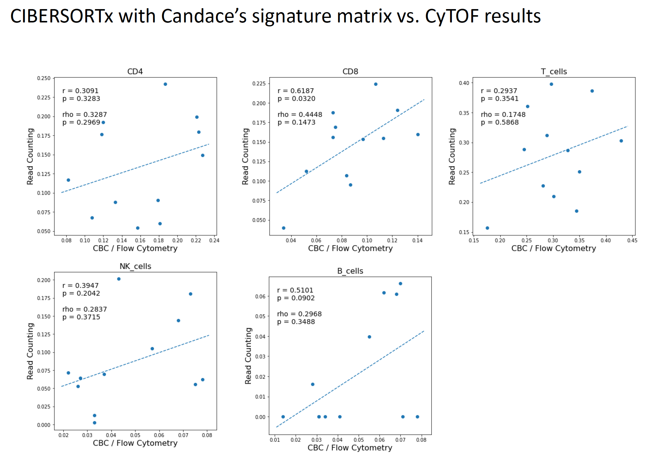

Slide 28
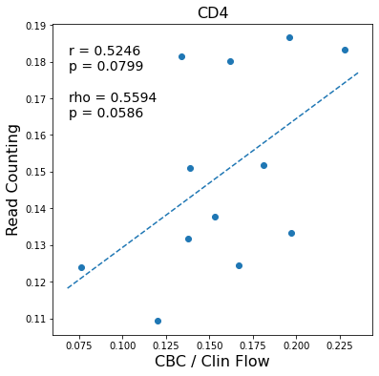
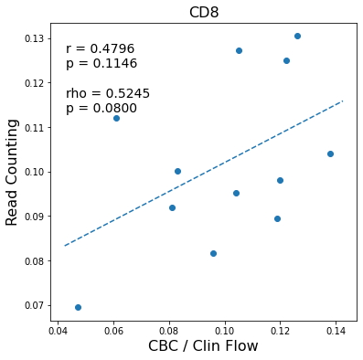
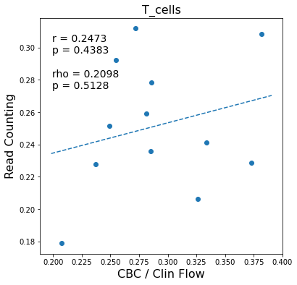
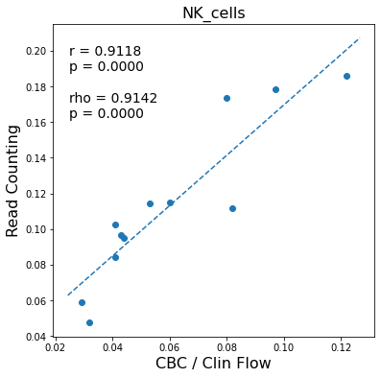
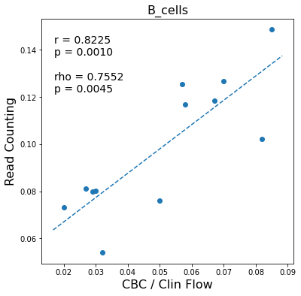
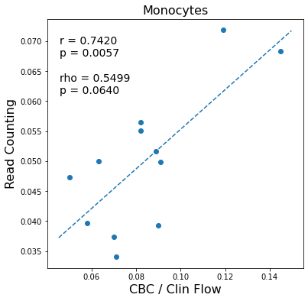
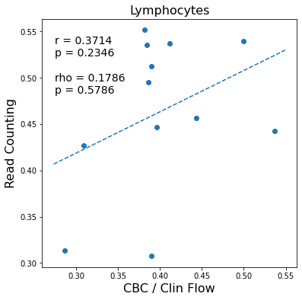
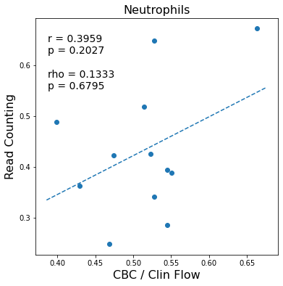
Compartment-wise 13CT reference with top 150 DMRs on July 6 updated Healthy Whole Blood CBC/Clin Flow (absolute RC)

Slide 29
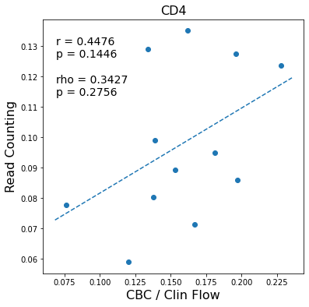







Compartment-wise 13CT reference with top 150 DMRs on July 6 updated Healthy Whole Blood CBC/Clin Flow (normalized RC)

Slide 30





Compartment-wise 13CT reference with top 150 DMRs on July 6 updated Healthy Whole Blood CyTOF (absolute RC)

Slide 31





Compartment-wise 13CT reference with top 150 DMRs on July 6 updated Healthy Whole Blood CyTOF (normalized RC)

Slide 32








Old 6CT reference on July 6 updated Healthy Whole Blood CBC/Clin Flow (absolute RC)

Slide 33








Old 6CT reference on July 6 updated Healthy Whole Blood CBC/Clin Flow (normalized RC)

Slide 34





Old 6CT reference on July 6 updated Healthy Whole Blood CyTOF (absolute RC)

Slide 35





Old 6CT reference on July 6 updated Healthy Whole Blood CyTOF (normalized RC)

Slide 36








Old 6CT vs CW13CT reference on July 6 updated Healthy Whole Blood (absolute RC)

Slide 37








Old 6CT reference vs. Candace’s SM with CIBERSORTx on July 6 updated Healthy Whole Blood (absolute RC)

Slide 38








CW13CT reference vs. Candace’s SM with CIBERSORTx on July 6 updated Healthy Whole Blood (absolute RC)

Slide 39
Healthy cfDNA

Slide 40
WB (previous result)
Ground truth: WB CBC/Clin Flow
13 cell type Ref
6cell type Ref
Candace’s SM
CSx
Absolute Read Counting
rho = 0.81
rho = 0.8
rho = 0.82
CBC/Clin Flow
CBC/Clin Flow
CBC/Clin Flow

Slide 41



cfDNA
Ground truth: WB CBC/Clin Flow
13 cell type Ref
6 cell type Ref
Candace’s SM
Absolute Read Counting
CSx
CBC/Clin Flow
CBC/Clin Flow
CBC/Clin Flow

Slide 42
WB (previous result)
Ground truth: CBC/Clin Flow without Mono
13 cell type Ref
6cell type Ref
Candace’s SM
CSx
Absolute Read Counting
rho = 0.89
rho = 0.83
rho = 0.84
CBC/Clin Flow
CBC/Clin Flow
CBC/Clin Flow

Slide 43



cfDNA
Ground truth: CBC/Clin Flow without Mono
13 cell type Ref
6 cell type Ref
Candace’s SM
Absolute Read Counting
CSx
CBC/Clin Flow
CBC/Clin Flow
CBC/Clin Flow

Slide 44
WB (previous result)
Ground truth: CyTOF without Mono
13 cell type Ref
6cell type Ref
Candace’s SM
CSx
Absolute Read Counting
rho = 0.82
rho = 0.72
rho = 0.78
CBC/CyTOF
CBC/CyTOF
CBC/CyTOF

Slide 45



cfDNA
Ground truth: CyTOF without Mono
13 cell type Ref
6 cell type Ref
Candace’s SM
Absolute Read Counting
CSx
CBC/CyTOF
CBC/CyTOF
CBC/CyTOF

Slide 46
Individual cell type correlation
WB
cfDNA
*both Clin flow and CyTOF are scaled by CBC

Slide 47
Individual cell type correlation
WB
cfDNA
*both Clin flow and CyTOF are scaled by CBC

Slide 48
Individual cell type correlation
Neu and B cell correlations are similar in WB and cfDNA
13 ct ref
6 ct ref
Candace’s SM
Correlation with CBC/Clin Flow

Slide 49







13CT ref cfDNA vs WB
In cfDNA, the read counting proportion of almost all cell types (except Neu) are smaller than WB

Slide 50







6CT ref cfDNA vs WB
In cfDNA, the read counting proportion of almost all cell types (except Neu) are smaller than WB

Slide 51







CSx (with Candace’s SM) cfDNA vs WB

Slide 52
Summary
In cfDNA, the absolute read counting proportion of almost all cell types (except Neu) are smaller than WB.
Neu and B cell correlations are similar in WB and cfDNA
(figures for cell type specific correlation of cfDNA are in the supplementary sides)

Slide 53
Whole blood RNA-seq deconvolution

Slide 54

Overview
Here we showed the whole blood (out latest data) RNA-seq deconvolution (CSx) result using LM22
To adjust LM22 with the ground truth, the following combination is performed:

Slide 55


Ground truth: CBC/Clin Flow
CSx on RNA-seq
(LM22)
CBC/Clin Flow
13 cell type Ref
6cell type Ref
Candace’s SM
WGBS
CSx
Absolute Read Counting
rho = 0.73
rho = 0.8
rho = 0.82
CBC/Clin Flow
CBC/Clin Flow
CBC/Clin Flow
Notes:
Bcell=nb+cb

Slide 56




Ground truth: CBC/CyTOF
CSx on RNA-seq
(LM22)
CBC/CyTOF
13 cell type Ref
6cell type Ref
Candace’s SM
WGBS
CSx
Absolute Read Counting
rho = 0.64
rho = 0.7
rho = 0.75
CBC/CyTOF
CBC/CyTOF
CBC/CyTOF
Notes:
Bcell=nb+cb

Slide 57






Correlation of 13CT ref on WGBS with CSx on RNA-seq
Neu shows the best correlation though with ground truth it is not great (next slide). Any issue with the ground truth?

Slide 58
Individual cell type correlation
*both Clin flow and CyTOF are scaled by CBC

Slide 59
WIP
Bisulfite conversion rate calculation (pipeline ready)
Wet lab data + dry lab meta data analysis
New extended reference generation

Slide 60
Supplementary

Slide 61





Comparison of Neutrophil correlation
13 cell type Ref
6 cell type Ref
Candace’s SM
WB
cfDNA

Slide 62






cfDNA: 6CT ref with July 6 CBC/Clin Flow ground truth
CBC/Clin Flow
CBC/Clin Flow
CBC/Clin Flow
CBC/Clin Flow
CBC/Clin Flow
CBC/Clin Flow
Notes:
(new subsetting)

Slide 63





cfDNA: 6CT ref with July 6 CyTOF ground truth
Notes:
(new subsetting)

Slide 64






cfDNA: CW13CT ref with July 6 CBC/Clin Flow ground truth

Slide 65





cfDNA: CW13CT ref with July 6 CyTOF ground truth

Slide 66






cfDNA: Candace’s SM CSx with July 6 CBC/Clin Flow ground truth

Slide 67





cfDNA: Candace’s SM CSx with July 6 CyTOF ground truth

Slide 68







cfDNA: Candace’s SM CSx vs 6CT ref

Slide 69







cfDNA: Candace’s SM CSx vs CW13CT ref

Slide 70







cfDNA: 6CT ref vs CW13CT ref

Slide 71






cfDNA: 6CT ref (old subsetting) vs 6CT ref (new subsetting)
Ignore scaling of x-axis! Should be *100

